Slide 1


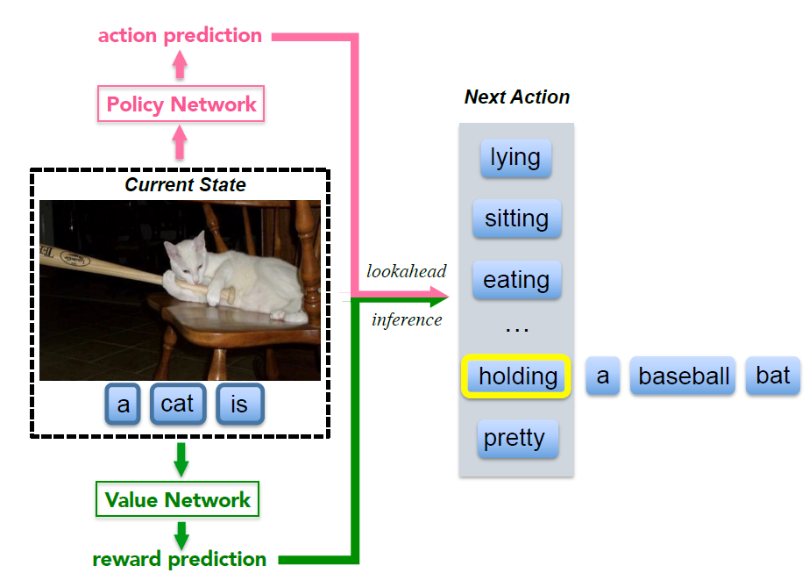
Image captioning based on deep reinforcement learning (DRL-CRNN)
Projektseminar Anwendungen Künstlicher Intelligenz
Viswambhar Reddy Yasa
65074
Venkata Mukund Kashyap Yedunuthala
65163

Slide 2

MOTIVATION

Slide 3
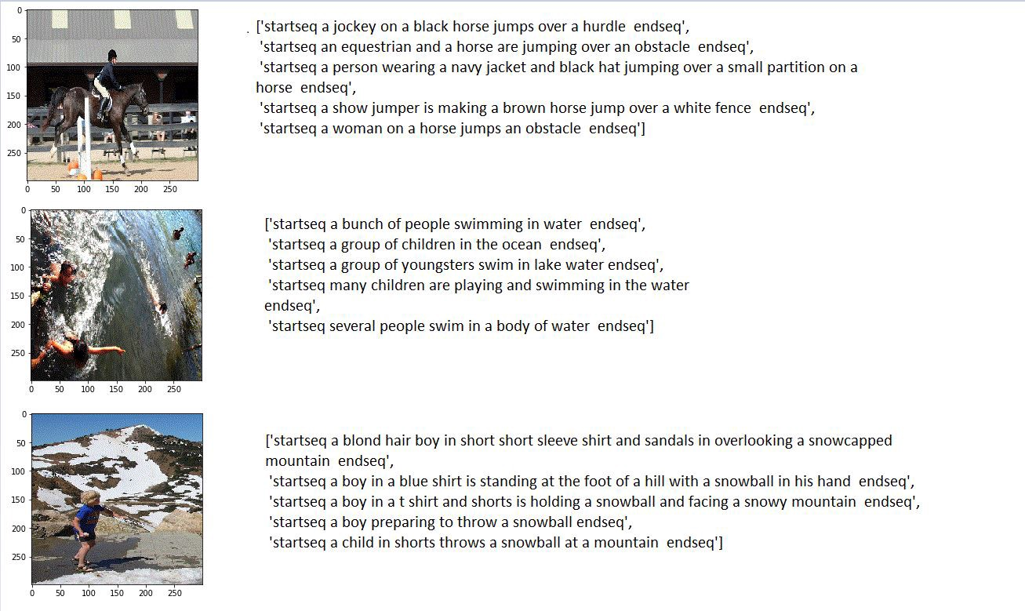
Datasets and pre-preprocessing
Datasets:
Flickr 8k dataset is used for pre-training the models. Flickr 8k consist of 8021 images with 5 caption for each image.
The dataset is divided into training and validation datasets with 6000 and 2021 images respectively.
Data Preprocessing:
The vocabulary is created from the captions available in training dataset.
The captions are cleansed by removing special characters, numbers ,punctuations and start, end tokens are added.
The captions are tokenized using tensorflow tokenization functions.
Some examples from dataset.

Slide 4
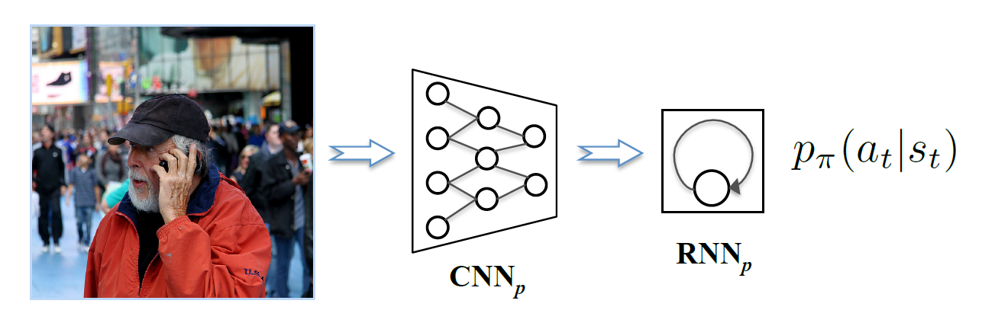
Training and optimization
Policy Net
Reward Net
Value Net
Introduction:
In Reinforcement learning, Policy Net is the agent in the environment which takes action based on the previous states.
Image Encoders | Text Decoder
Xception | LSTM
Inception | LSTM
ResNet | LSTM
Policy Net architecture ^{[1]}
Loss= categorical cross entropy

Slide 5
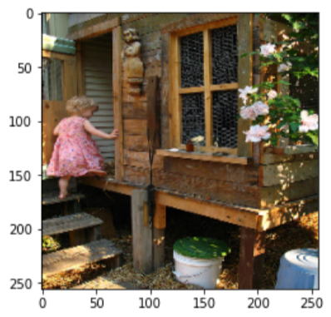
Training and optimization
Policy Net
Reward Net
Value Net
Training Data:
Inputs:
Outputs:
“startseq child in pink dress is climbing up set of stairs in an entry way endseq”
[[ 2 0 0 0 0 0 0 0 0 0 0 0 0 0 0 0 0 0 0 0]
[ 2 43 0 0 0 0 0 0 0 0 0 0 0 0 0 0 0 0 0 0]
[ 2 43 4 0 0 0 0 0 0 0 0 0 0 0 0 0 0 0 0 0]
[ 2 43 4 88 0 0 0 0 0 0 0 0 0 0 0 0 0 0 0 0]
[ 2 43 4 88 170 0 0 0 0 0 0 0 0 0 0 0 0 0 0 0]
[ 2 43 4 88 170 7 0 0 0 0 0 0 0 0 0 0 0 0 0 0]
[ 2 43 4 88 170 7 118 0 0 0 0 0 0 0 0 0 0 0 0 0]
[ 2 43 4 88 170 7 118 56 0 0 0 0 0 0 0 0 0 0 0 0]
[ 2 43 4 88 170 7 118 56 392 0 0 0 0 0 0 0 0 0 0 0]
[ 2 43 4 88 170 7 118 56 392 12 0 0 0 0 0 0 0 0 0 0]
[ 2 43 4 88 170 7 118 56 392 12 393 0 0 0 0 0 0 0 0 0]
[ 2 43 4 88 170 7 118 56 392 12 393 4 0 0 0 0 0 0 0 0]
[ 2 43 4 88 170 7 118 56 392 12 393 4 28 0 0 0 0 0 0 0]
[ 2 43 4 88 170 7 118 56 392 12 393 4 28 4381 0 0 0 0 0 0]]
[43,
4,
88,
170,
7,
118,
56,
392,
12,
393,
4,
28,
4381,
640]
Image and text sequence
Next word in sequence

Slide 6
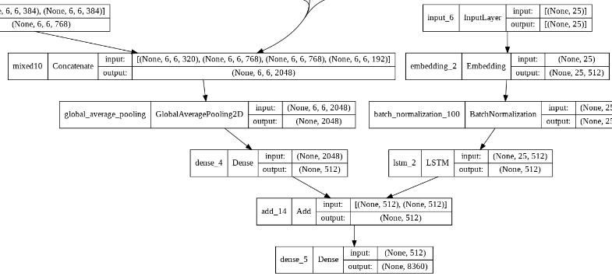
Training and optimization
Policy Net
Reward Net
Value Net
Architecture:
layers | shape
Image input | (None,256,256,3)
Text input | (None, max length)
Image encoder output | (None, 2048)
Image Dense layer | (None, Embed_size)
Text decoder output | (None, Embed_size)
Image and text combine layer | (None, Embed_size)
Final Output | (None, Vocab_size)
Embed_size=512 , Vocab_size=8360, max length =25
Image Encoder | Text Decoder | Total parameters | Trainable params | Non Trainable params
Xception | LSTM | 32,580,816 | 11,718,312 | 20,862,504
Inception | LSTM | 35,569,704 | 11,980,968 | 23,588,736
ResNet | LSTM | 33,522,120 | 11,718,312 | 21,803,808

Slide 7
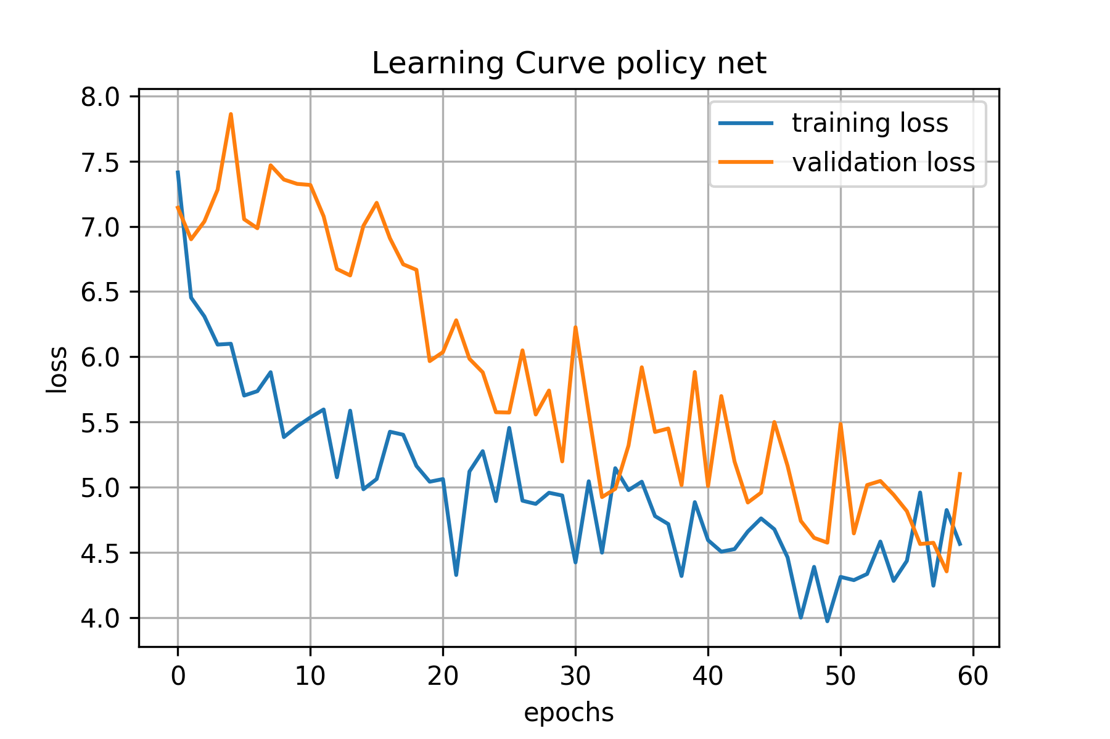
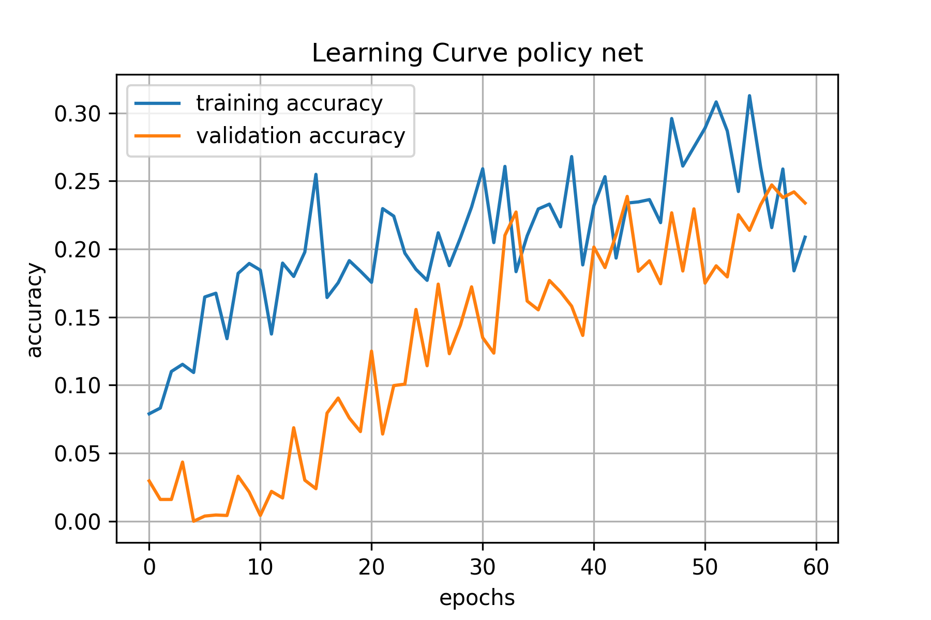
Training and optimization
Policy Net
Reward Net
Value Net
Initial Training: (Random initialization of hyper-parameters)
Batch Size | Learning rate | Optimizer | Image Encoder | Text Decoder
2 images | 0.001 | SGD | Inception | LSTM

Slide 8
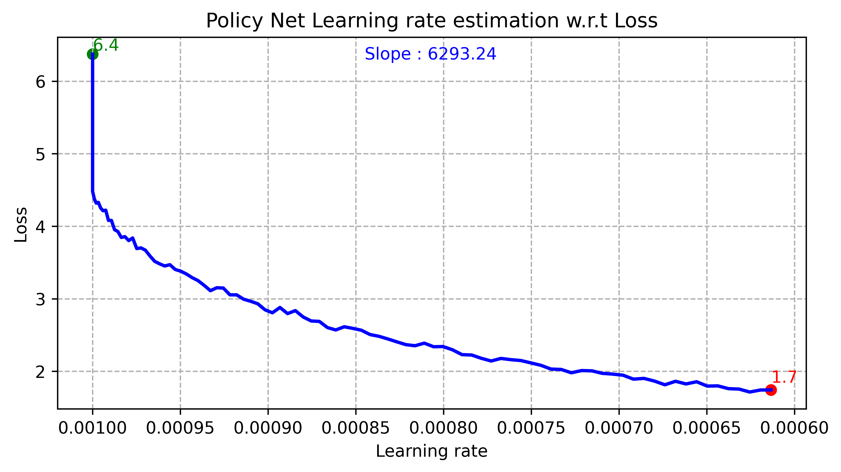
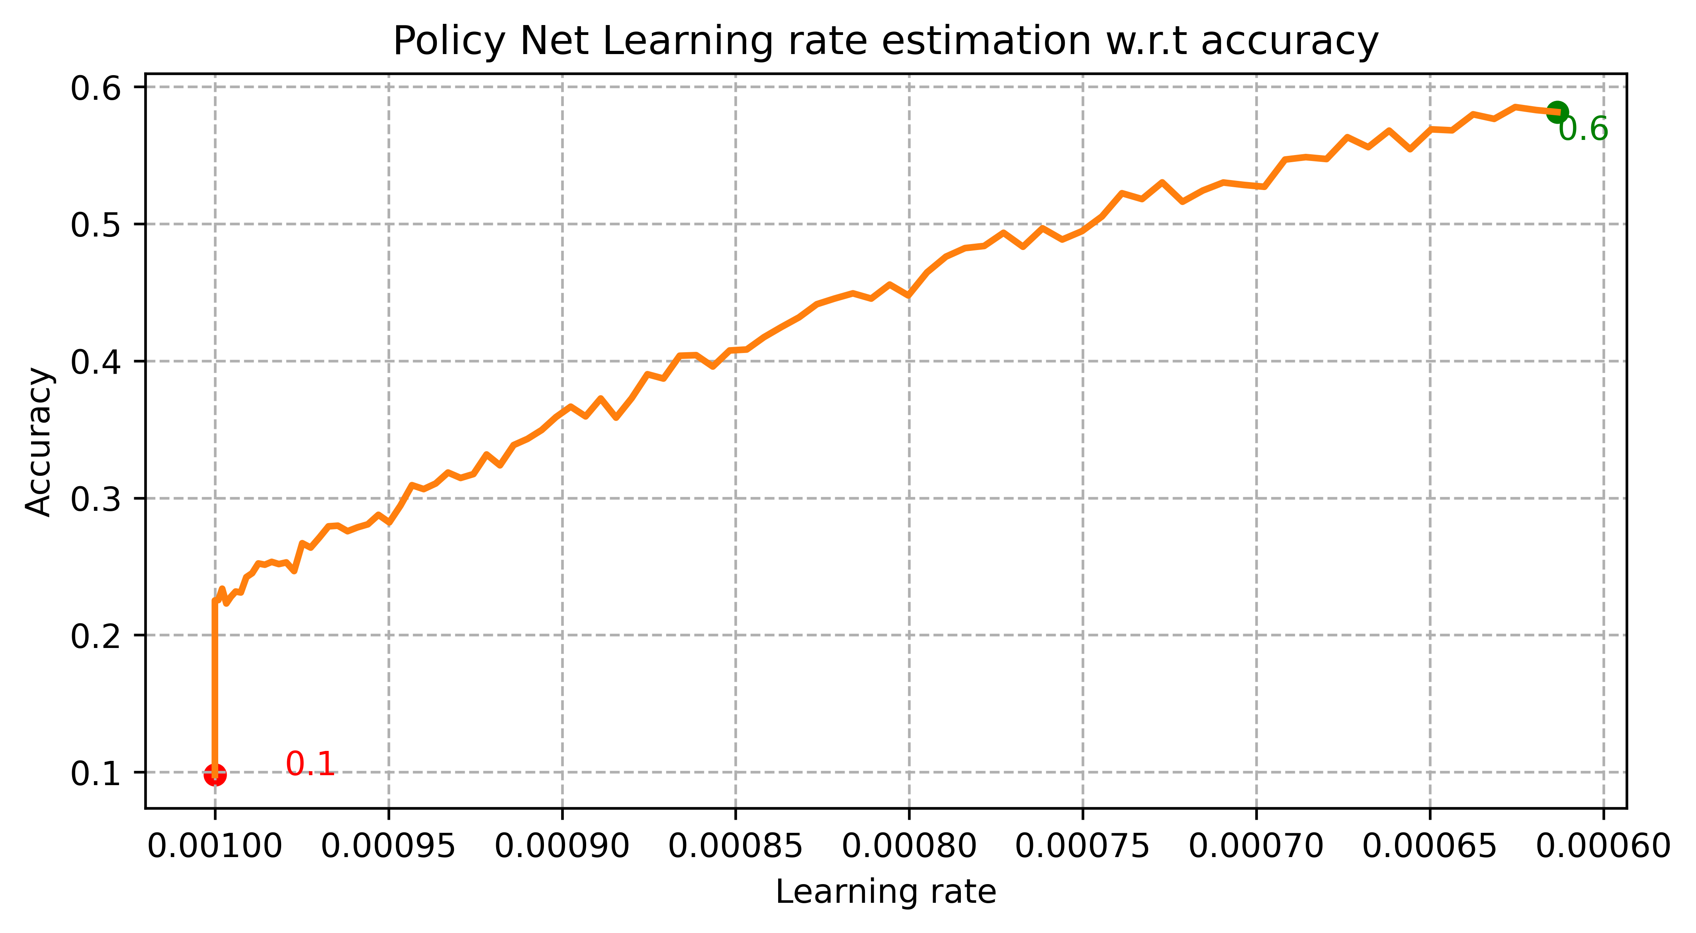
Training and optimization
Policy Net
Reward Net
Value Net
Training: (Experimentation- Learning rate and Batch size estimation)
Batch Size | Learning rate | Optimizer | Image Encoder | Text Decoder
8 images | ? | Adam | Inception | LSTM

Slide 9
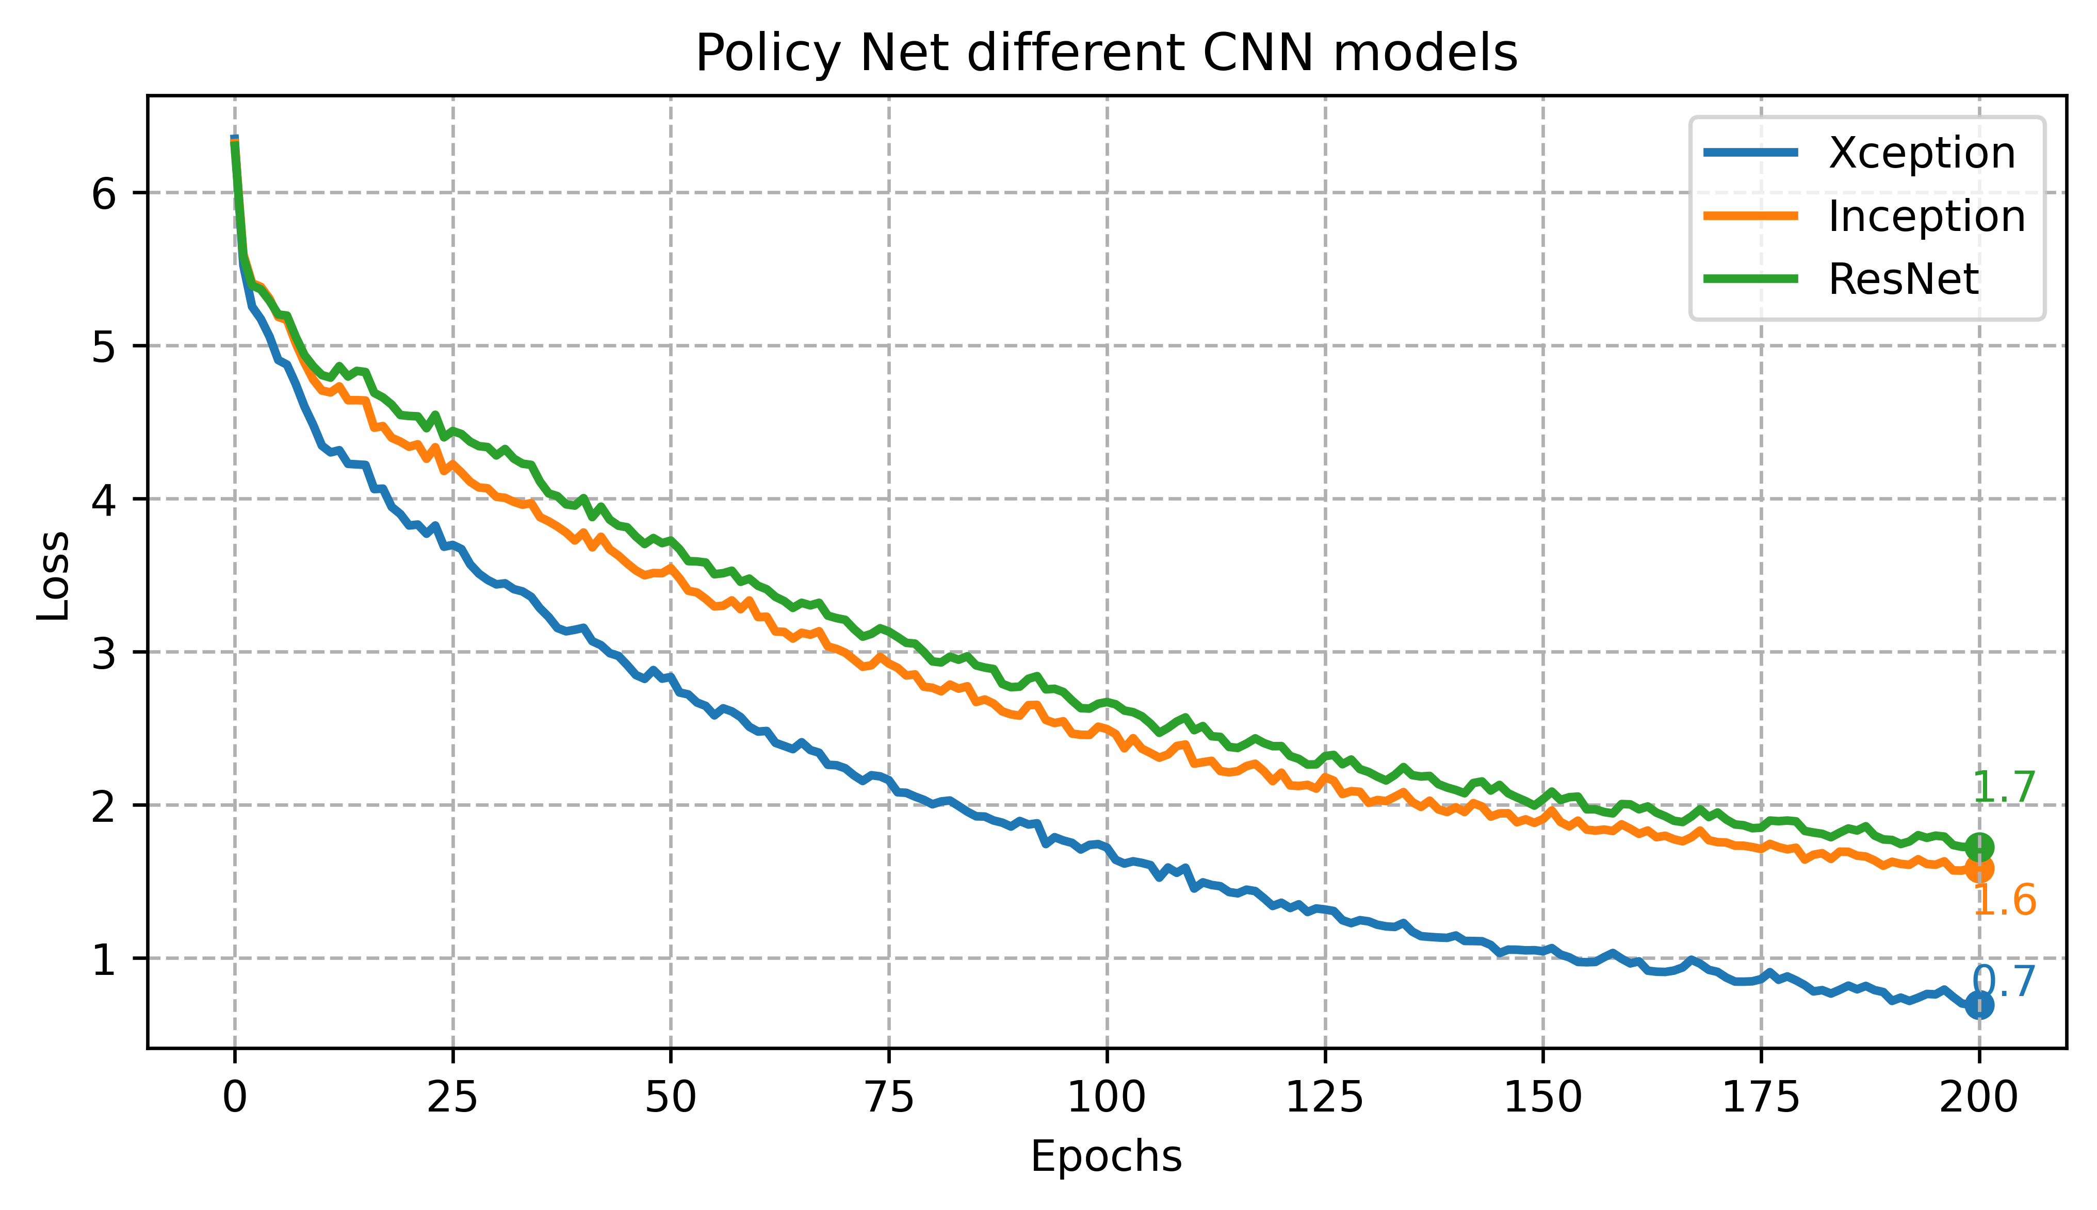
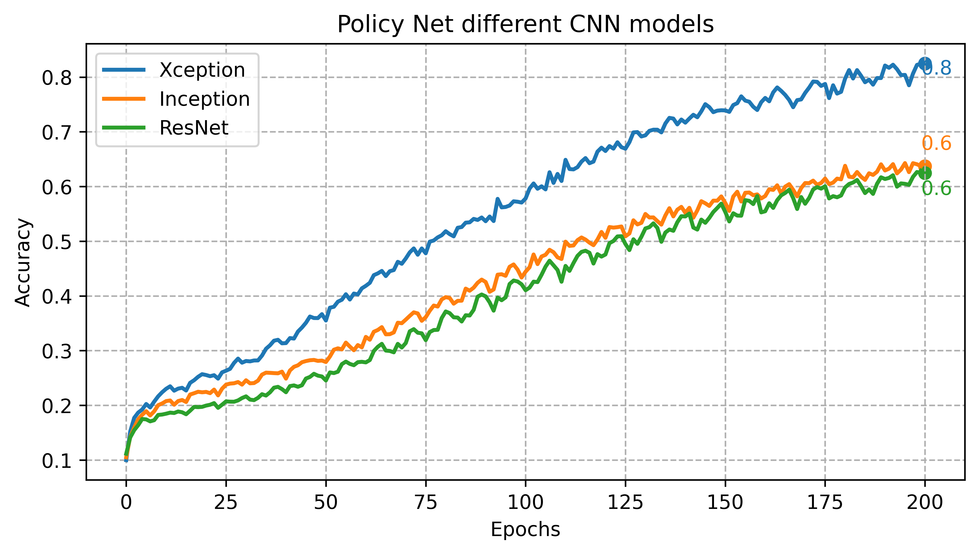
Training and optimization
Policy Net
Reward Net
Value Net
Training: (Experimentation- Image Encoder selection)
Batch Size | Learning rate | Optimizer | Image Encoder | Text Decoder
8 images | 0.0001 | Adam | ? | LSTM

Slide 10
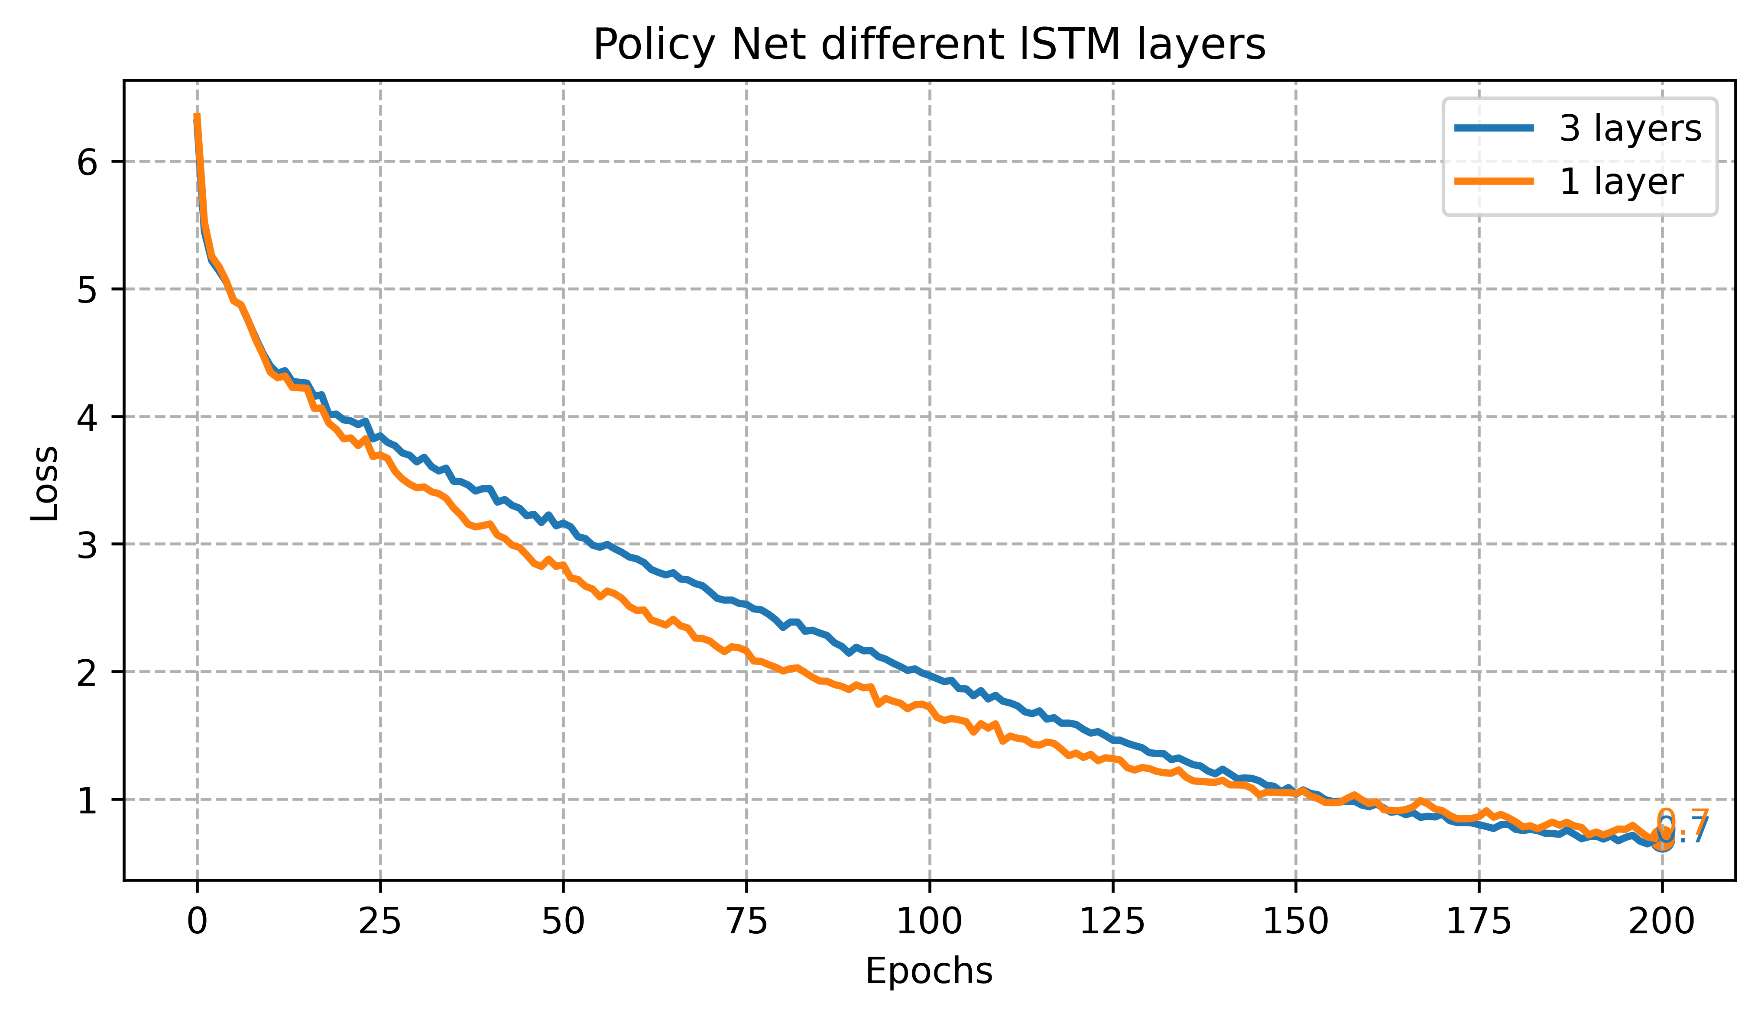
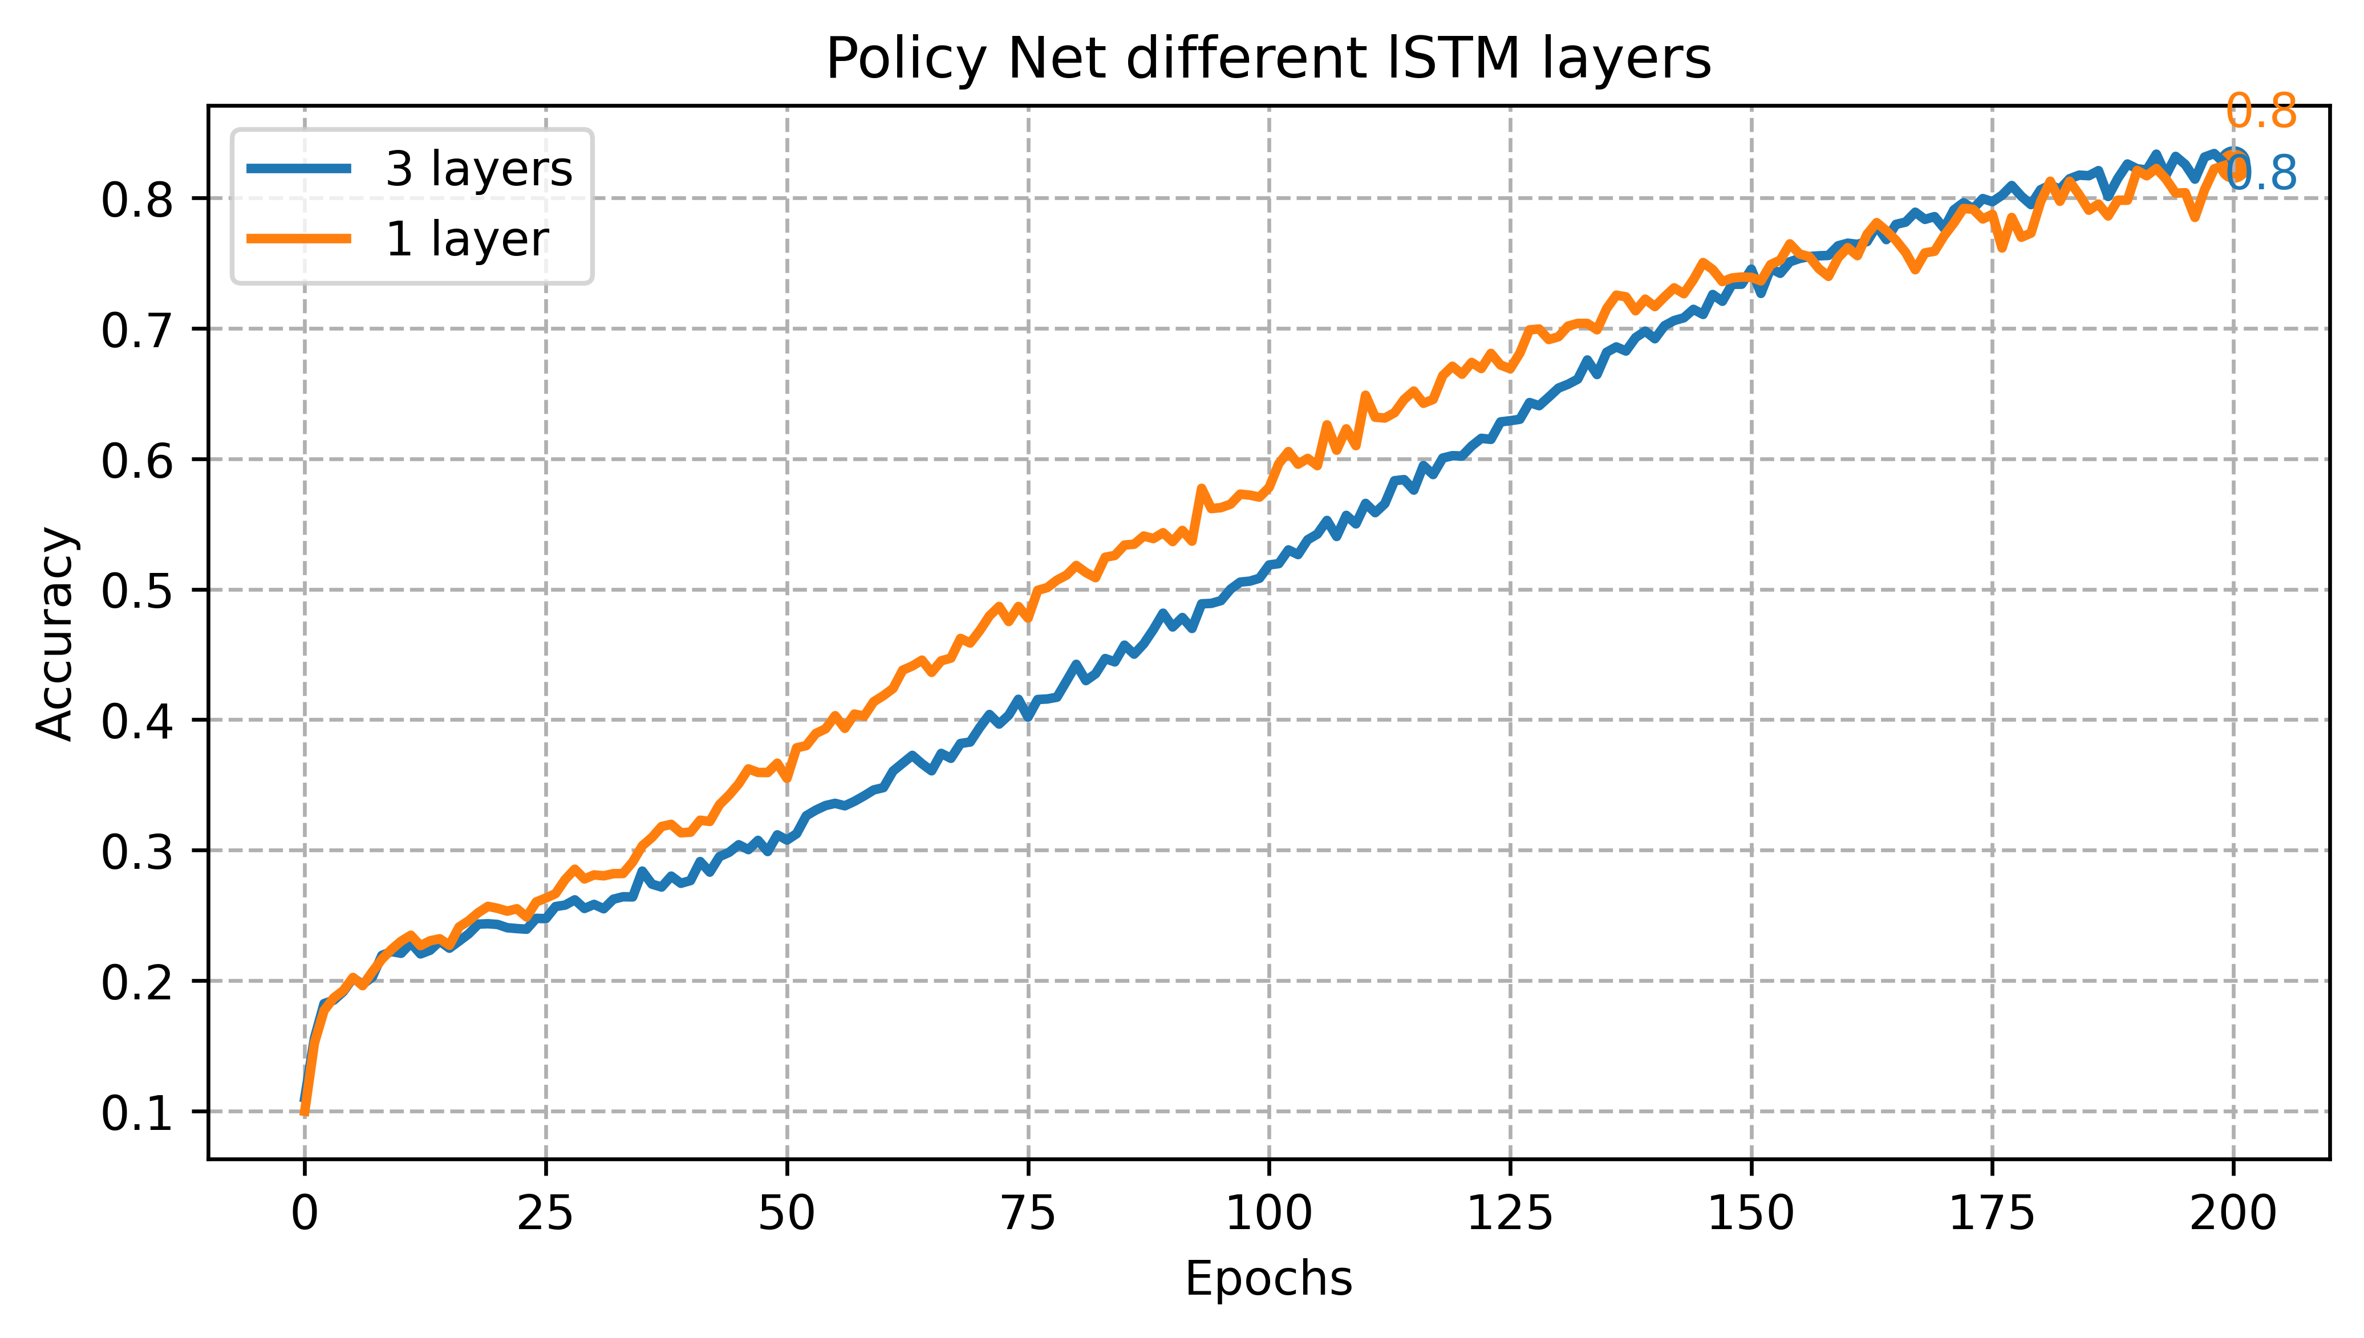
Training and optimization
Policy Net
Reward Net
Value Net
Training: (Experimentation- Text decoder selection)
Batch Size | Learning rate | Optimizer | Image Encoder | Text Decoder
8 images | 0.0001 | Adam | Xception | ?
Image Encoder | Text Decoder | Trainable params
Xception | LSTM | 11,718,312
Xception | 3 LSTM | 14,345,896

Slide 11
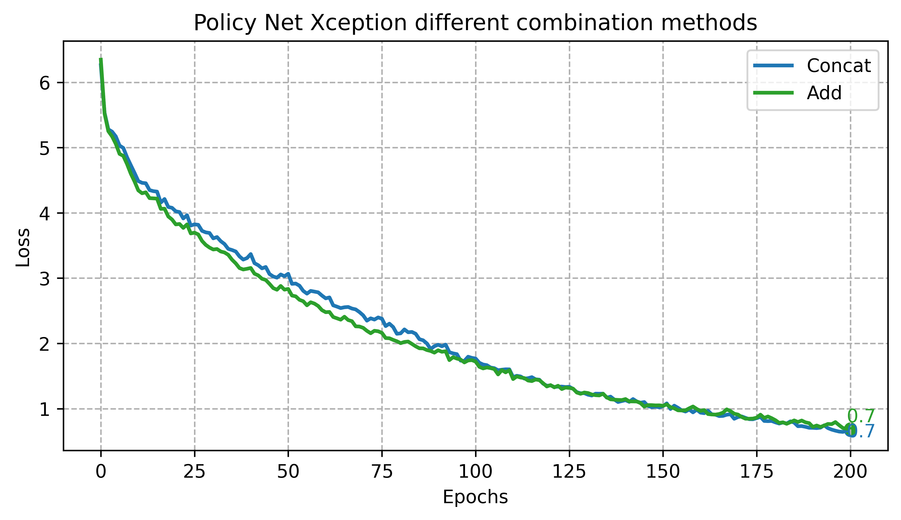
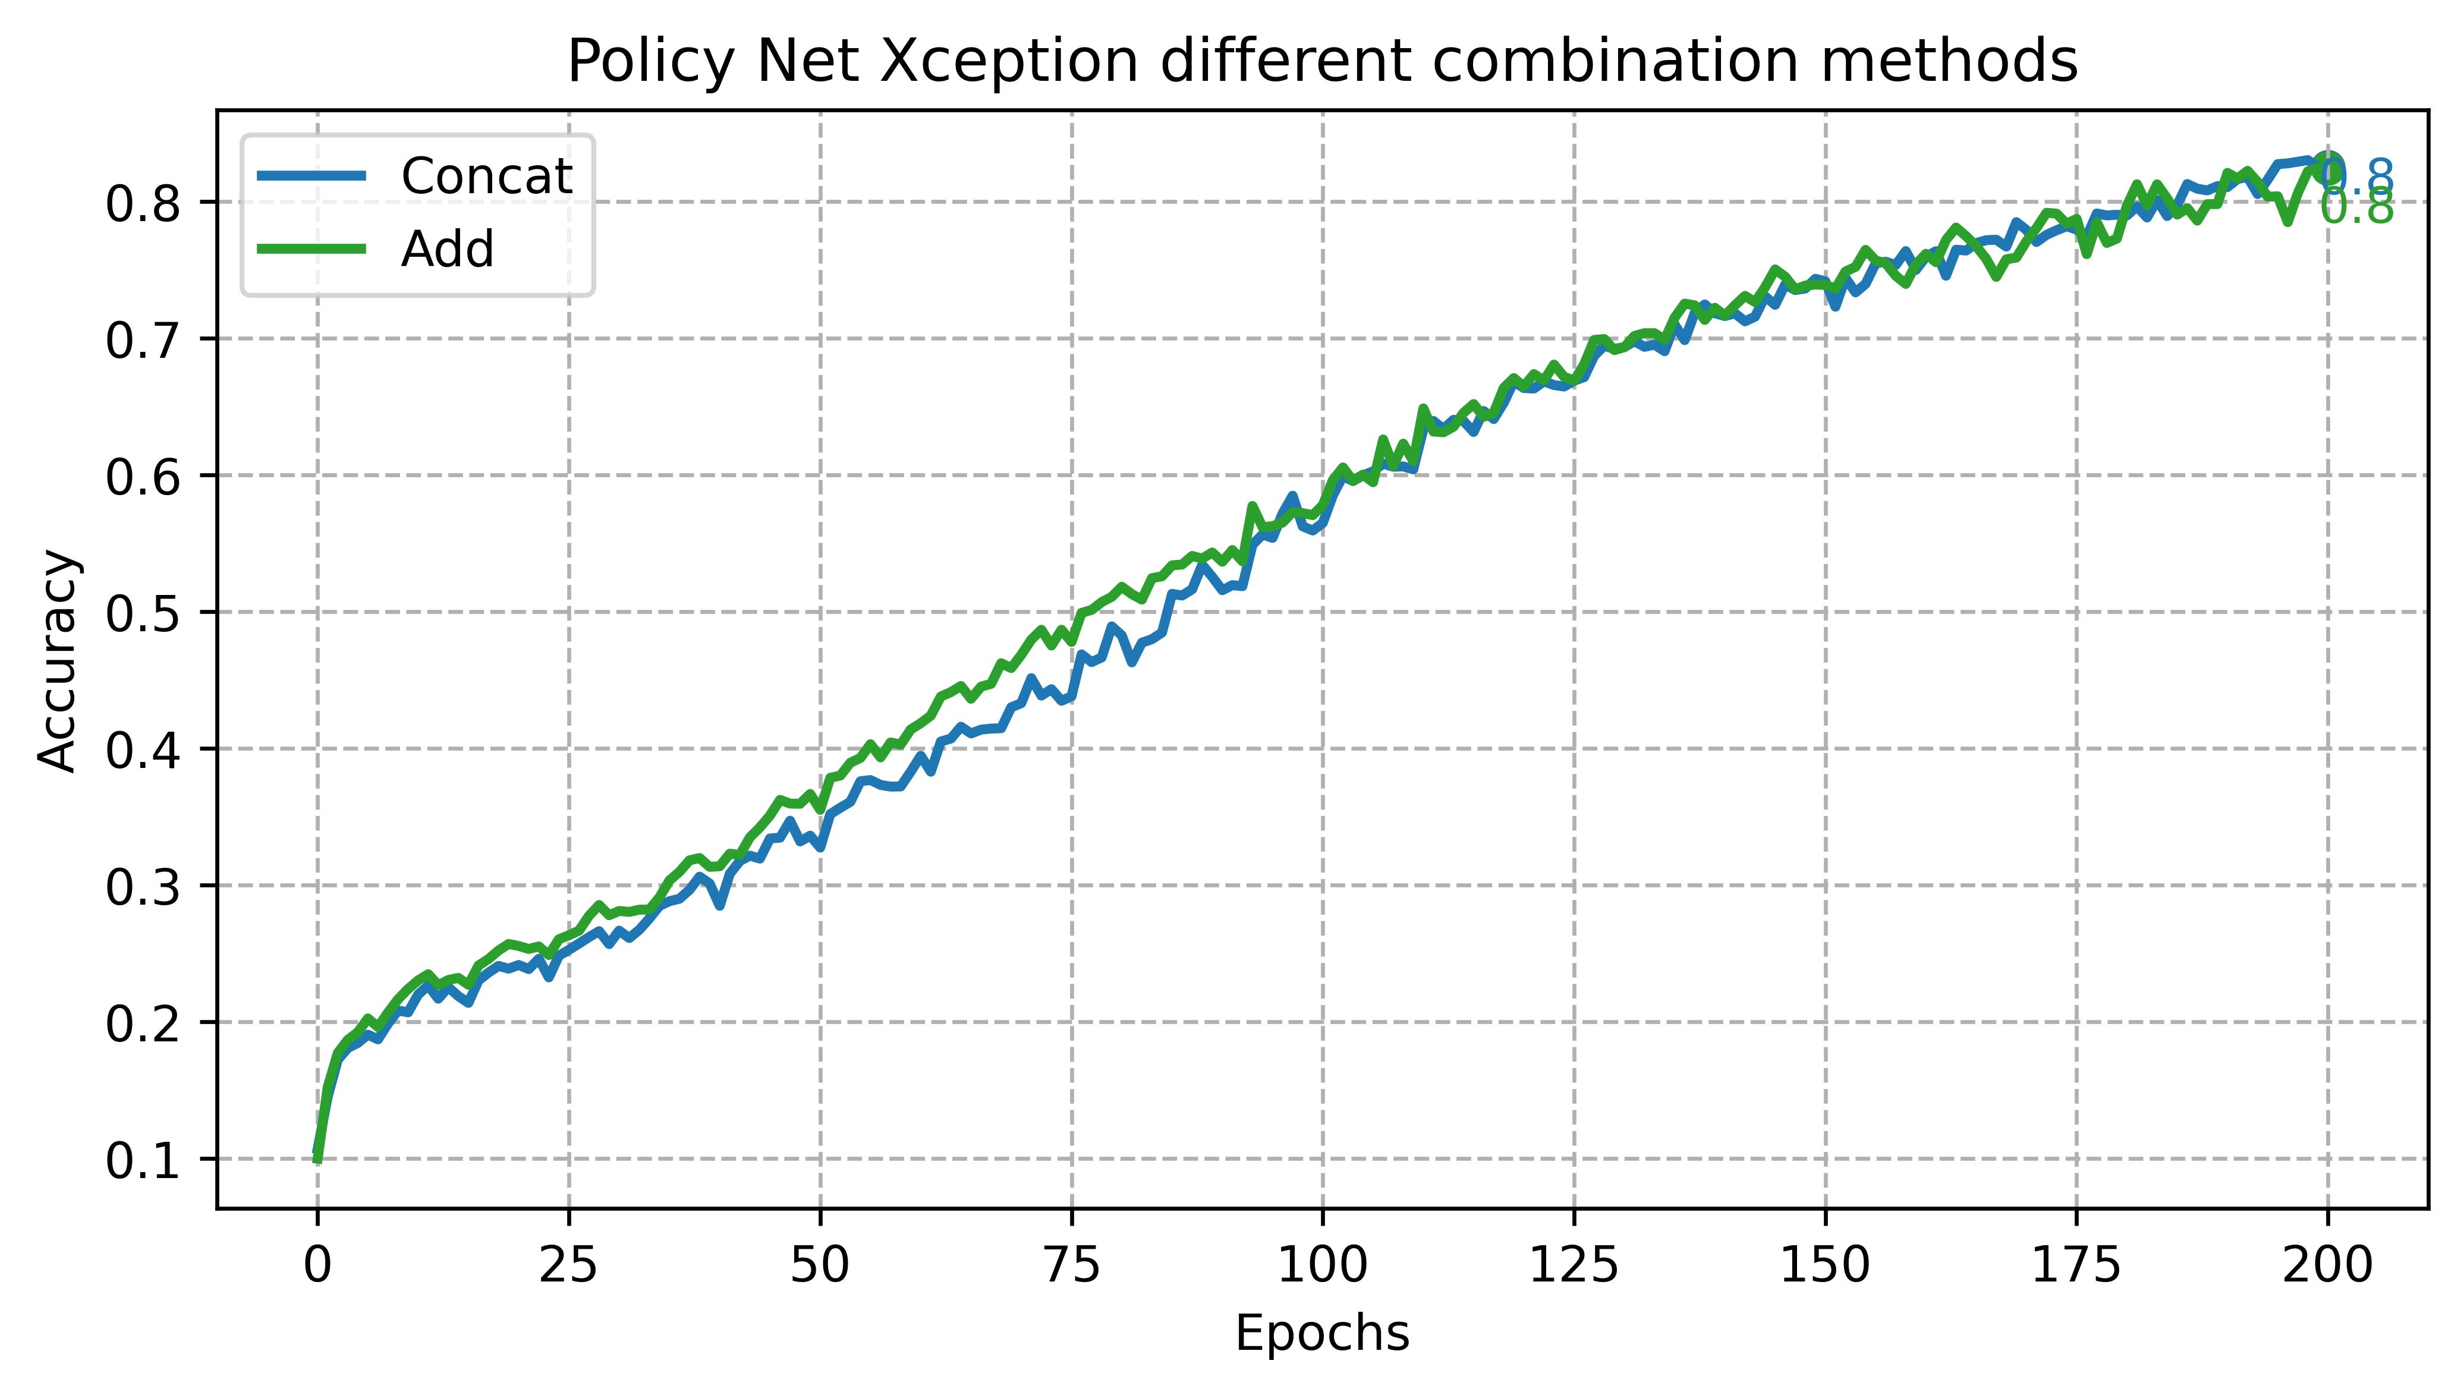
Training and optimization
Policy Net
Reward Net
Value Net
Training: (Model Selection)
Final parameters of policy Net
Batch Size | Learning rate | Optimizer | Image Encoder | Text Decoder
8 images | 0.0001 | Adam | Xception | 1 LSTM

Slide 12
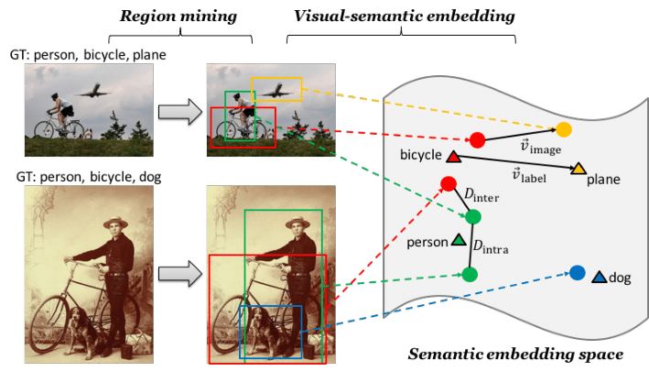
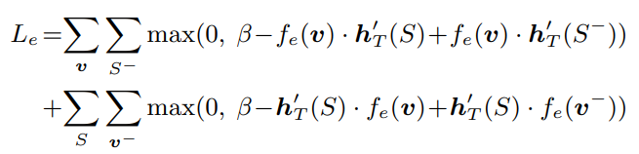
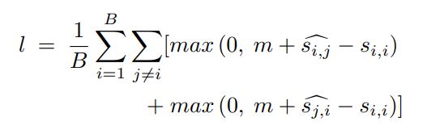
Training and optimization
Policy Net
Reward Net
Value Net
Introduction:
Image Encoders | Text Decoder
Xception | LSTM
Loss= Bi-directional marginal loss ^{[2]}
Illustration of visual sematic embedding ^{[2]}
Loss= Hard Negative Bi-directional marginal loss ^{[3]}

Slide 13
Training and optimization
Policy Net
Reward Net
Value Net
Training Data:
Inputs:
Outputs:
“startseq child in pink dress is climbing up set of stairs in an entry way endseq”
Image feature vector shape: (1, 512)
Text sequence vector shape: (1, 512)
[[ 2 43 4 88 170 7 118 56 392 12 393 4 28 4381 0 0 0 0 0 0]]
Image and text sequence

Slide 14
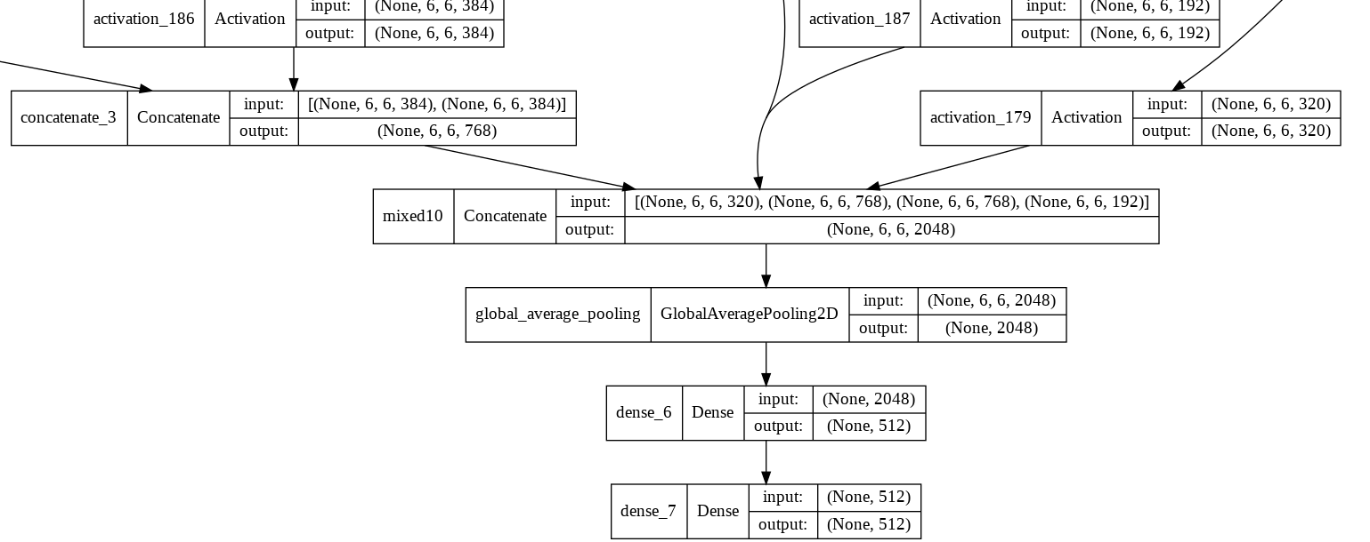
Training and optimization
Policy Net
Reward Net
Value Net
Architecture:
layers | shape
Image input | (None,256,256,3)
Text input | (None, max length)
Image encoder output | (None, 2048)
Image Dense layer | (None, 512)
Text decoder output | (None, 256)
Image feature vector | (None, Embed_size)
Text feature vector | (None, Embed_size)
Embed_size=512 , Vocab_size=8360, max length =25
Image Encoder | Text Decoder | Total parameters | Trainable params | Non Trainable params
Xception | LSTM | 29,758,752 | 7,954,944 | 21,803,808

Slide 15
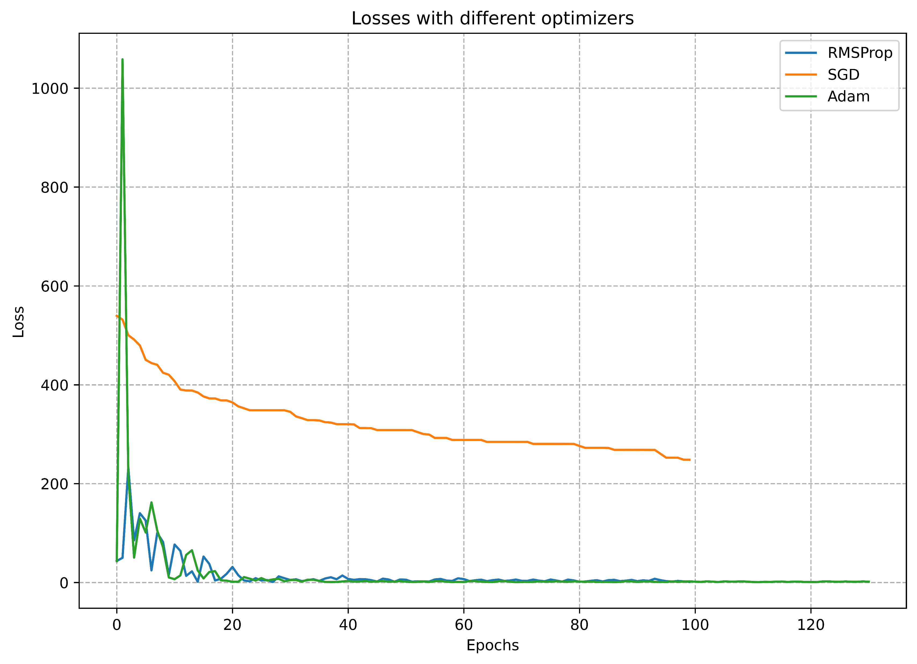
Training and optimization
Policy Net
Reward Net
Value Net
Training: Experimentation- Optimizer selection
Batch Size | 8 images
Learning Rate | 0.0001
Optimizer | ?
Image Encoder | Xception
Text Decoder | LSTM

Slide 16
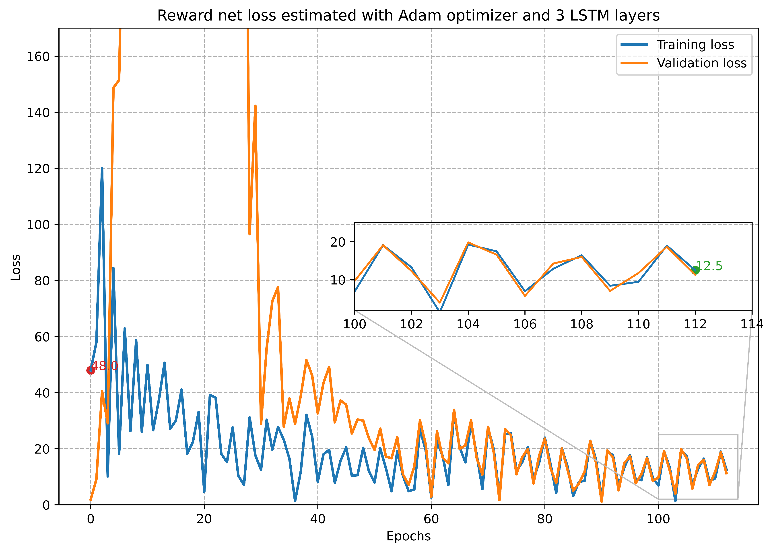
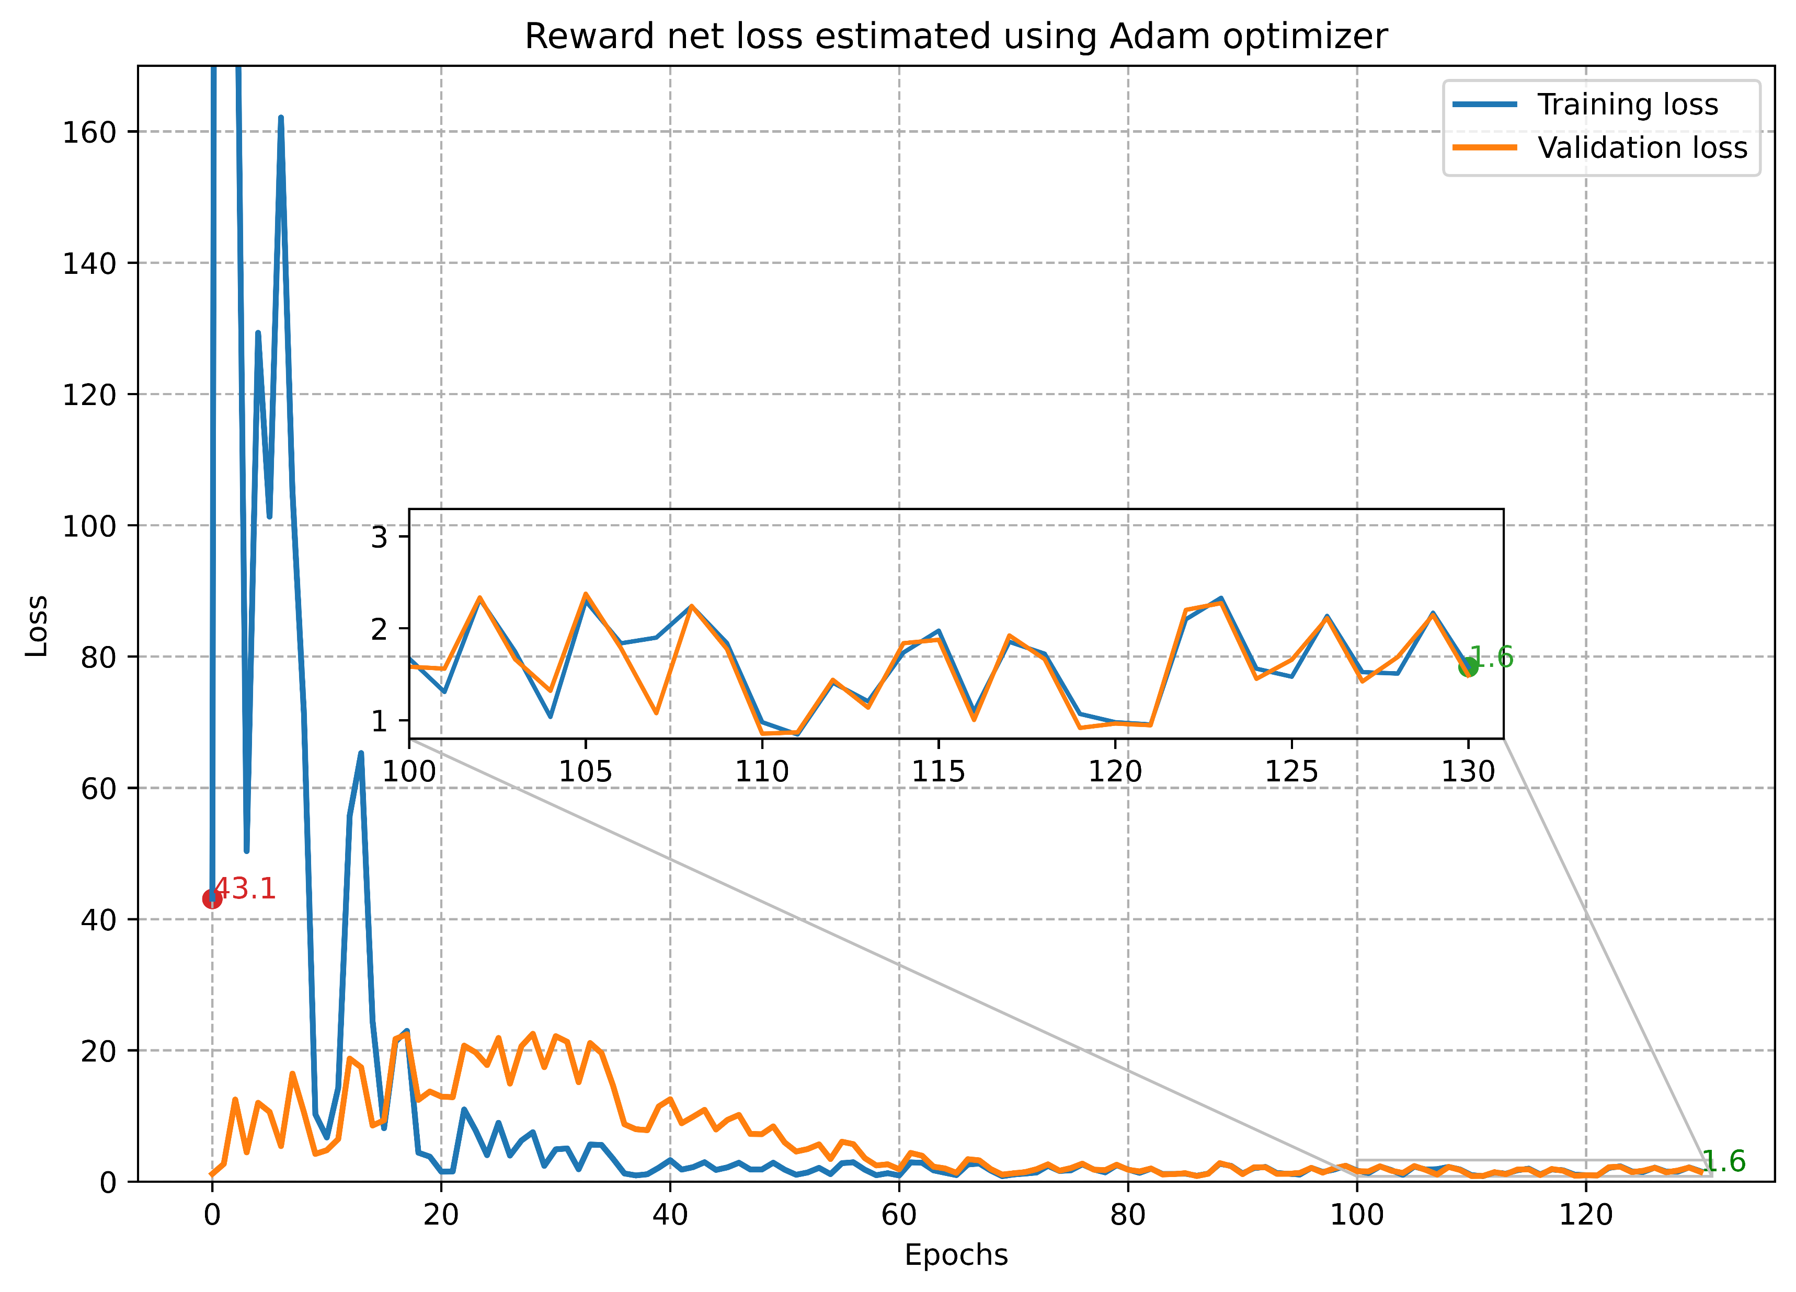
Training and optimization
Policy Net
Reward Net
Value Net
Training: Experimentation- Text decoder selection
Batch Size | Learning rate | Optimizer | Image Encoder | Text Decoder
8 images | 0.0001 | RMSprop | Xception | ?

Slide 17
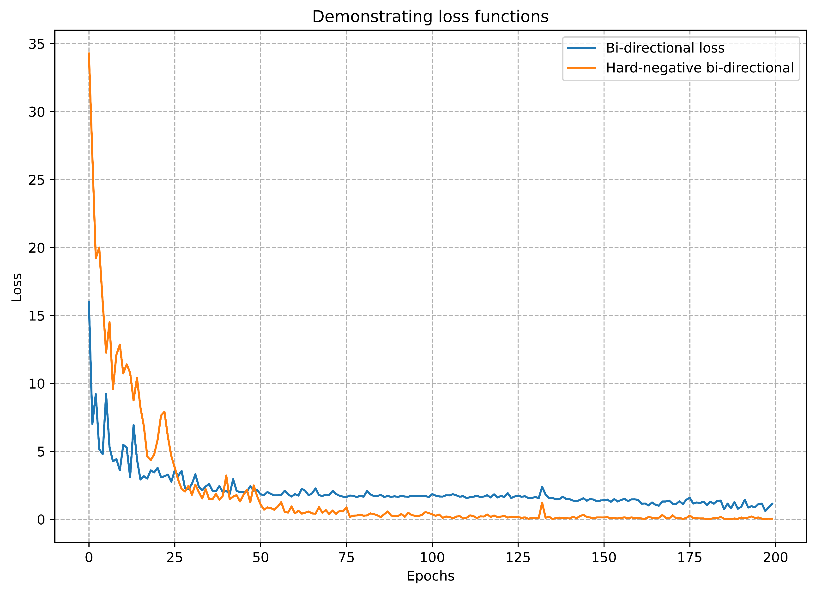
Training and optimization
Policy Net
Reward Net
Value Net
Training: Experimentation- Text decoder selection
Batch Size | 32 images
Learning Rate | 0.0001
Optimizer | RMSprop
Image Encoder | Xception
Text Decoder | LSTM
Loss Function | Hard negative bi-directional

Slide 18
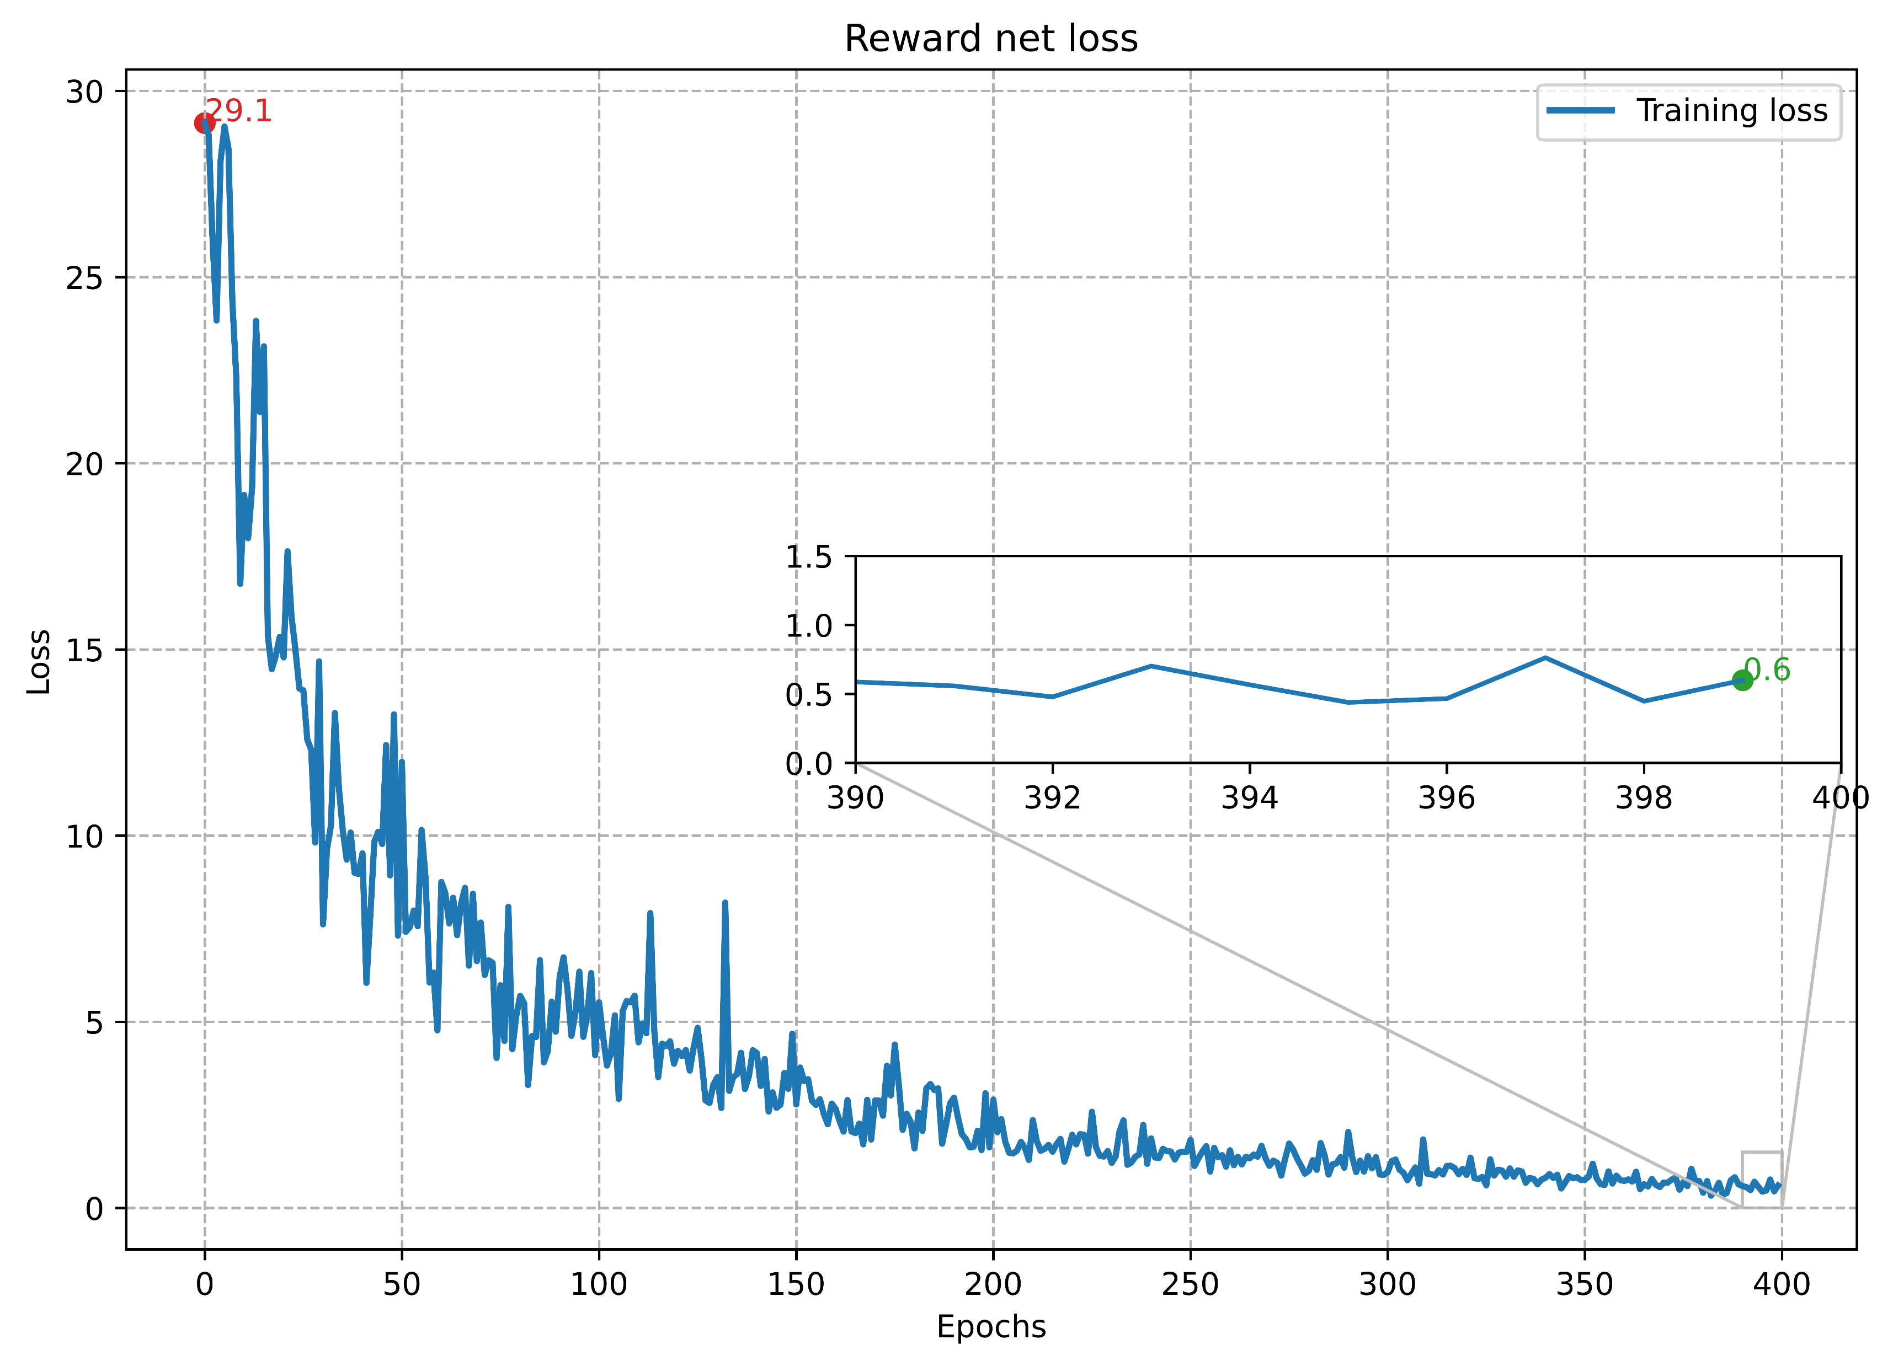
Training and optimization
Policy Net
Reward Net
Value Net
Training: Model selection
Batch Size | 32 images
Learning Rate | 0.0001
Optimizer | RMSprop
Image Encoder | Xception
Text Decoder | LSTM
Loss Function | Hard negative bi-directional

Slide 19
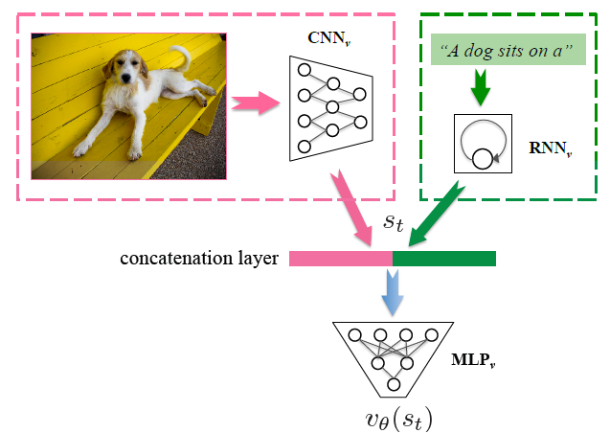
Training and optimization
Policy Net
Reward Net
Value Net
Introduction:
In Reinforcement learning, Value Net is the critic which evaluate the agent and compares it to award a reward based on which the next action is taken.
Image Encoders | Text Decoder
Xception | LSTM
Loss= Mean Squared error
Value Net architecture ^{[1]}

Slide 20
Training and optimization
Policy Net
Reward Net
Value Net
Training Data:
Inputs:
Outputs:
“startseq child in pink dress is climbing up set of stairs in an entry way endseq”
MLP output shape : (1,1)
[[ 2 43 4 88 170 7 118 56 392 12 393 4 28 4381 0 0 0 0 0 0]]
Image and text sequence

Slide 21
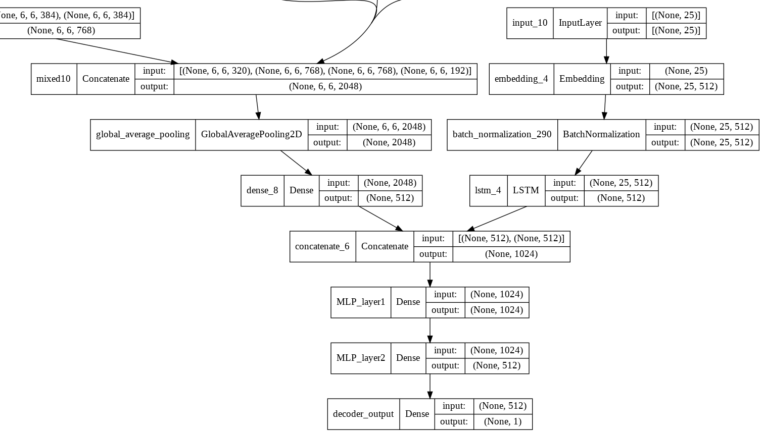
Training and optimization
Policy Net
Reward Net
Value Net
Architecture:
layers | shape
Image input | (None,256,256,3)
Text input | (None, max length)
Image encoder output | (None, 2048)
Text decoder output | (None, Embed_size)
Image and text combine layer | (None, Embed_size)
Final Output | (None, 1)
Embed_size=512 , Vocab_size=8360, max length =25
Image Encoder | Text Decoder | Total parameters | Trainable params | Non Trainable params
Xception | LSTM | 30,808,353 | 9,004,545 | 21,803,808

Slide 22
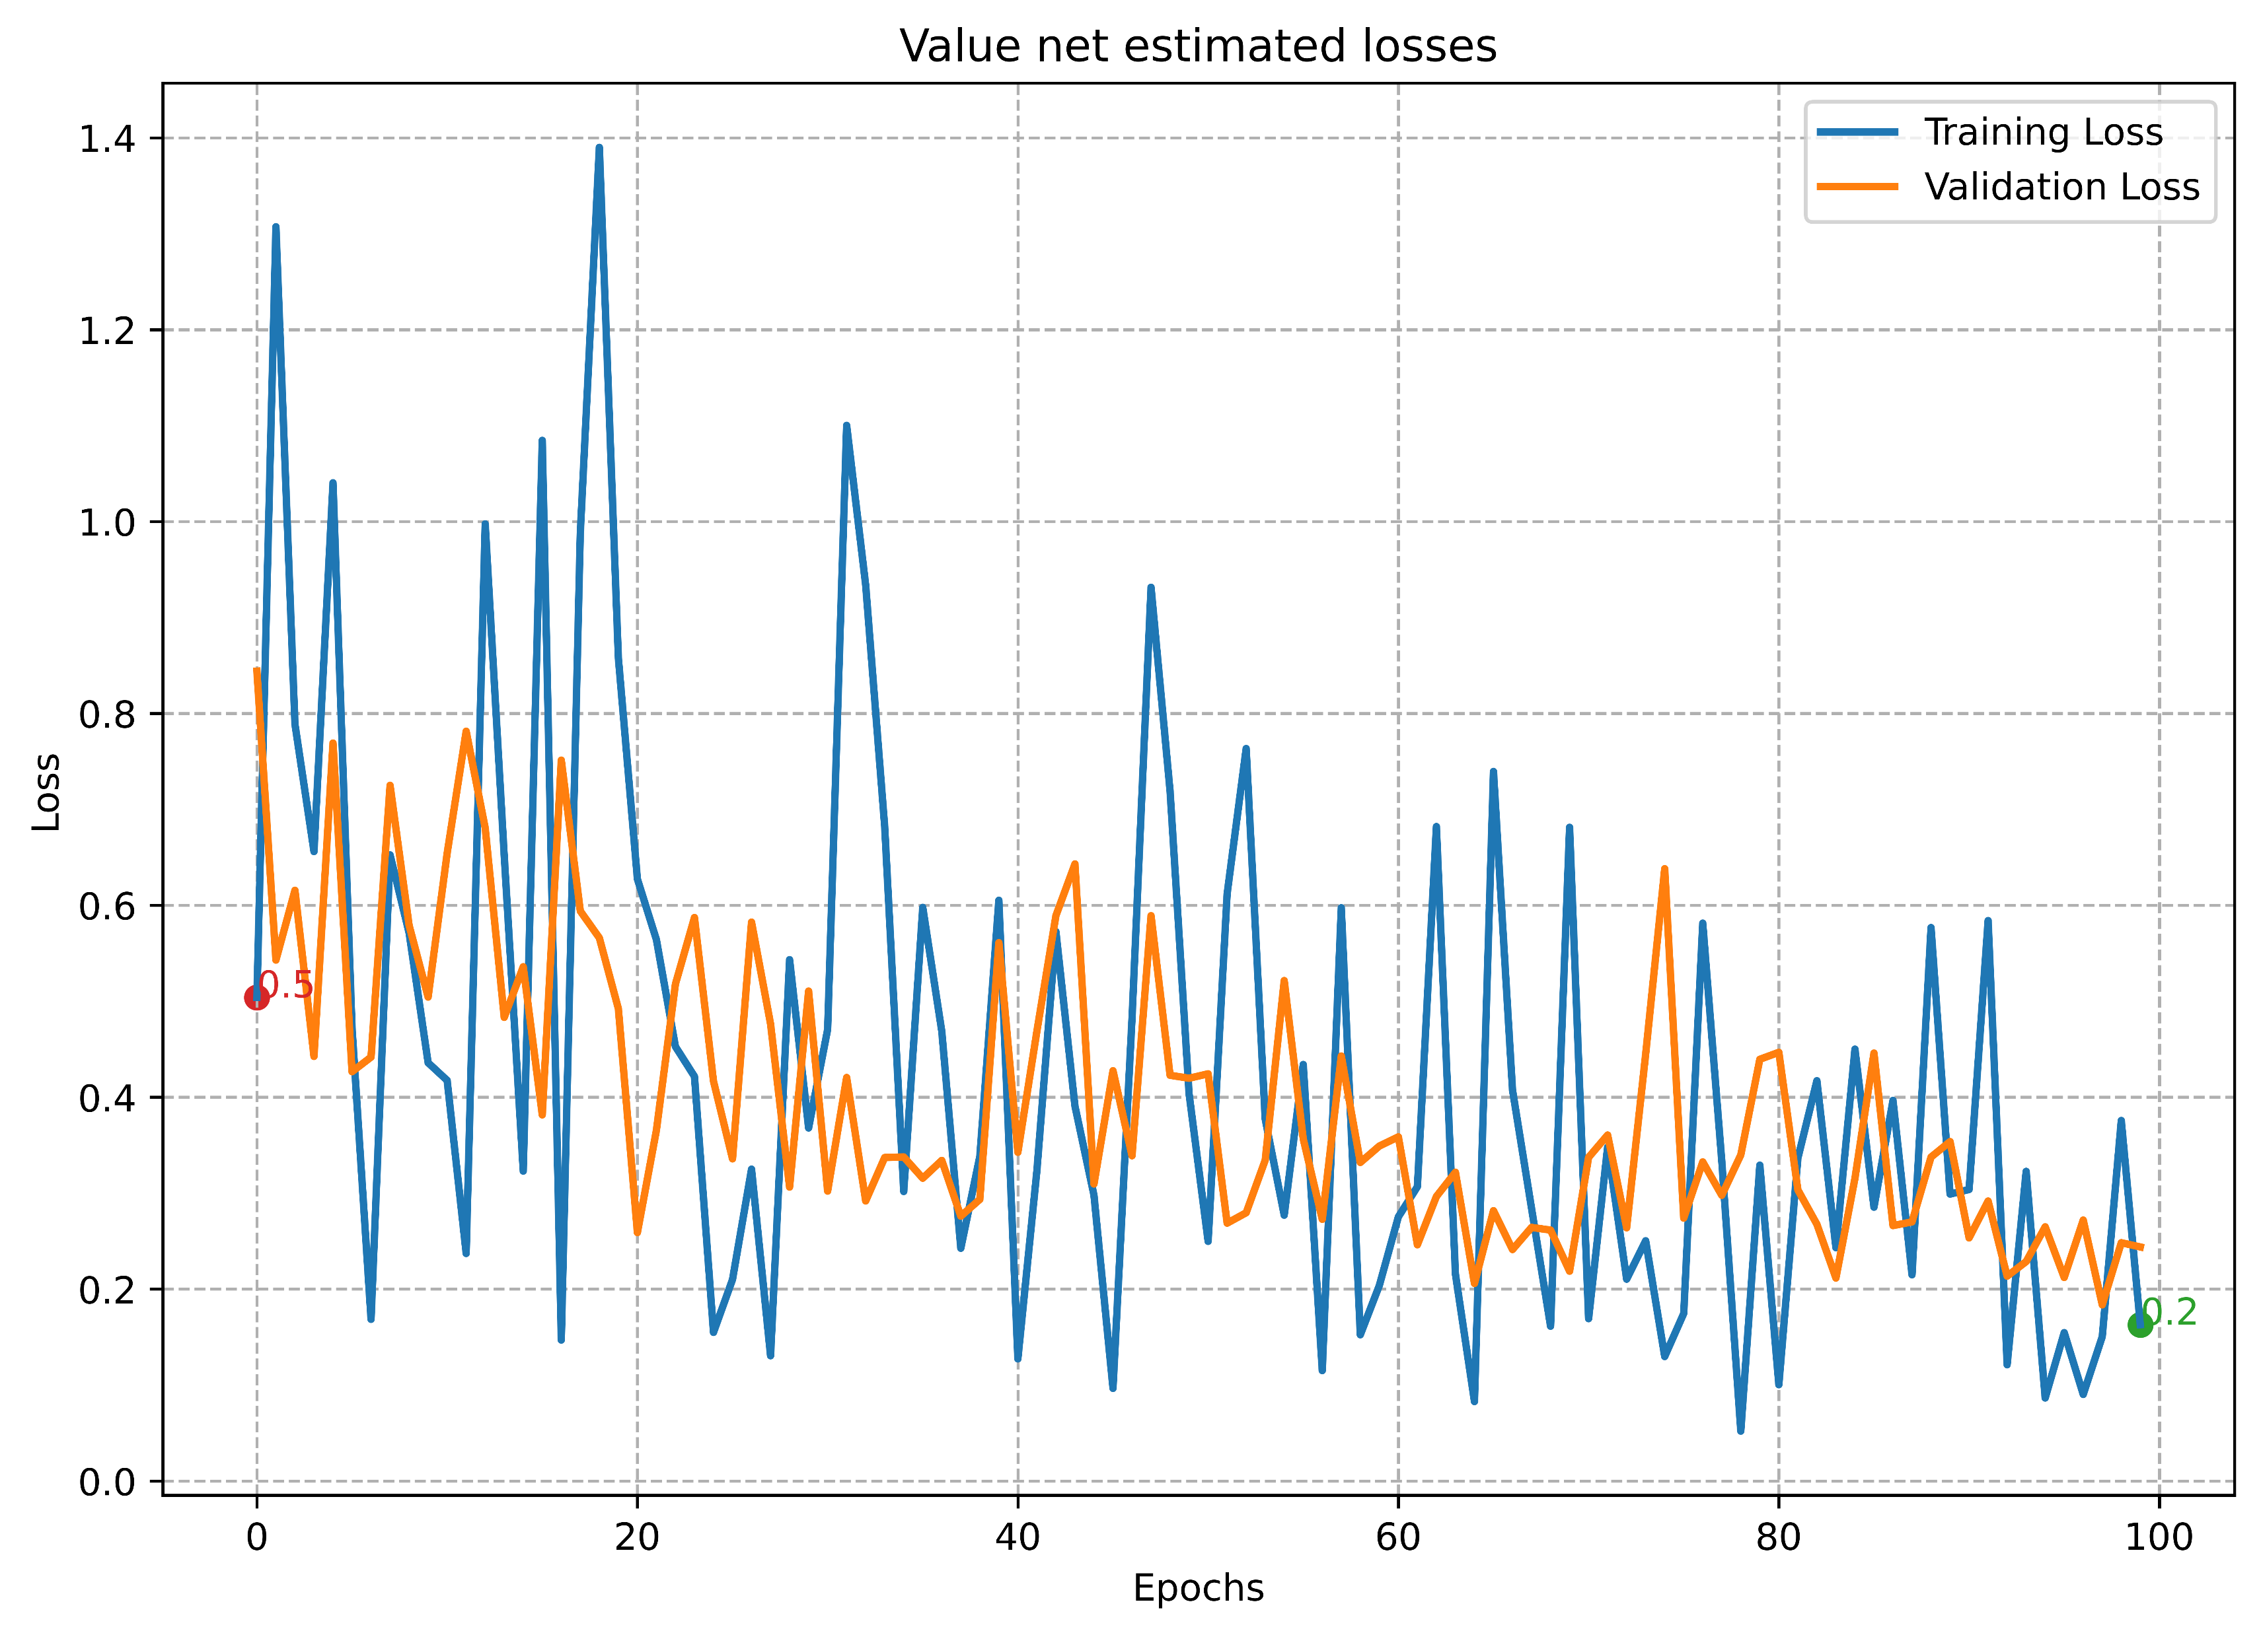
Training and optimization
Policy Net
Reward Net
Value Net
Initial Training:
Batch Size | 2 images
Learning Rate | 0.001
Optimizer | Adam
Image Encoder | Xception
Text Decoder | LSTM
Loss Function | Mean Square Error

Slide 23
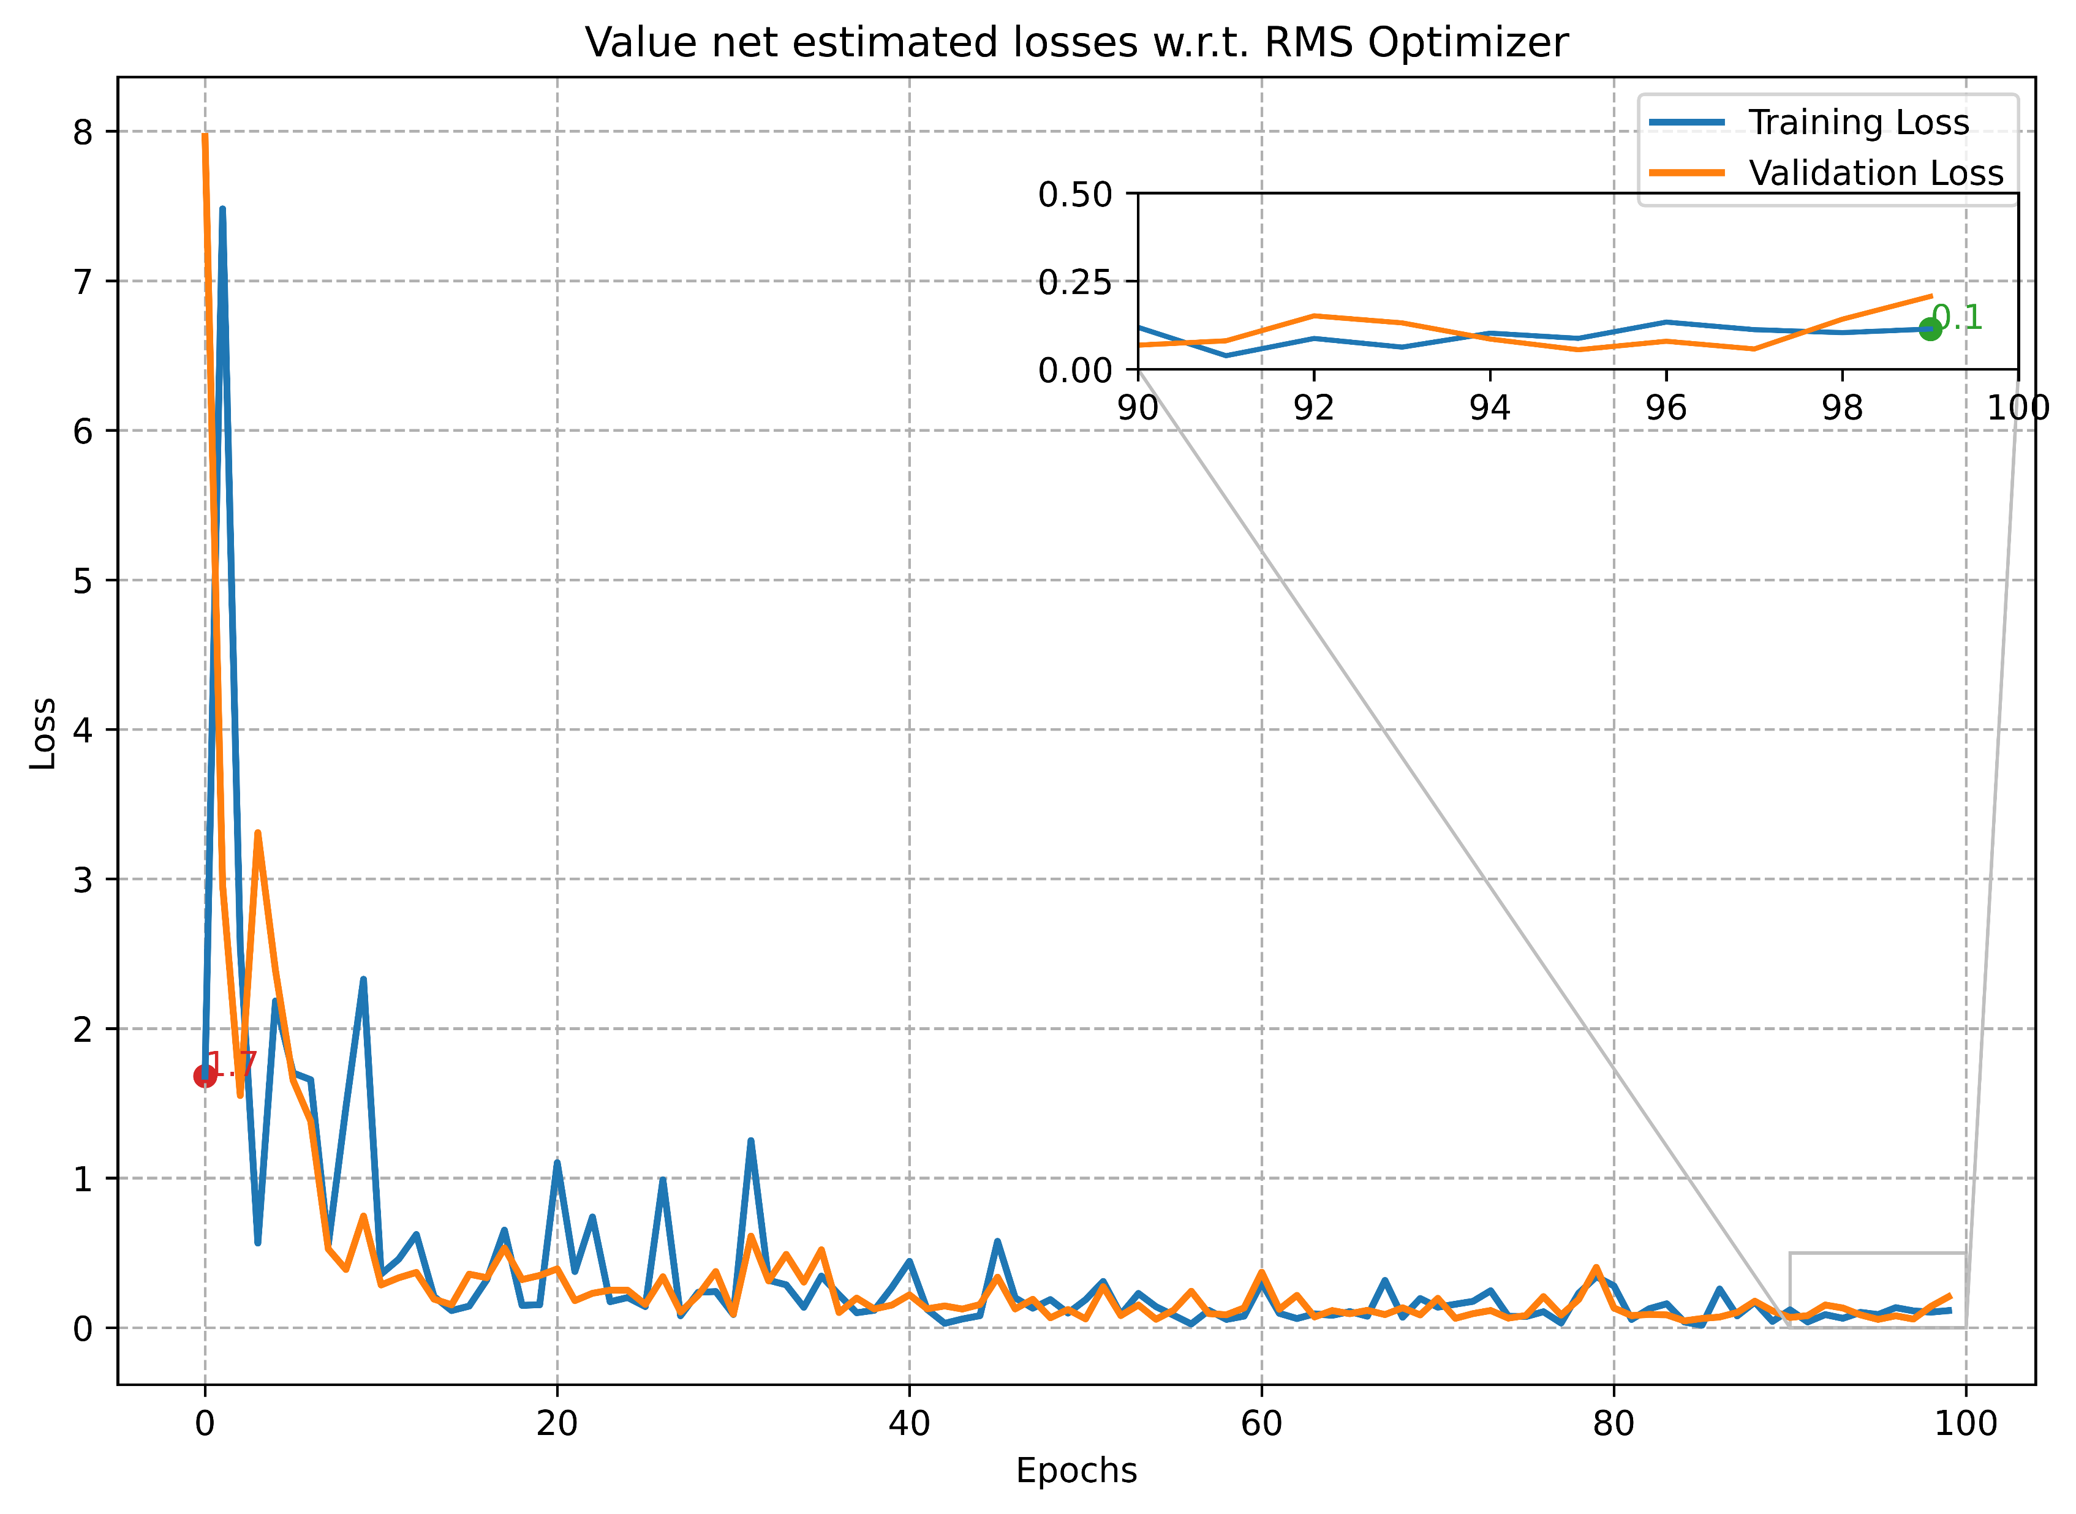
Training and optimization
Policy Net
Reward Net
Value Net
Training:
Batch Size | 16 images
Learning Rate | 0.0001
Optimizer | RMSprop
Image Encoder | Xception
Text Decoder | LSTM
Loss Function | Mean Square Error

Slide 24
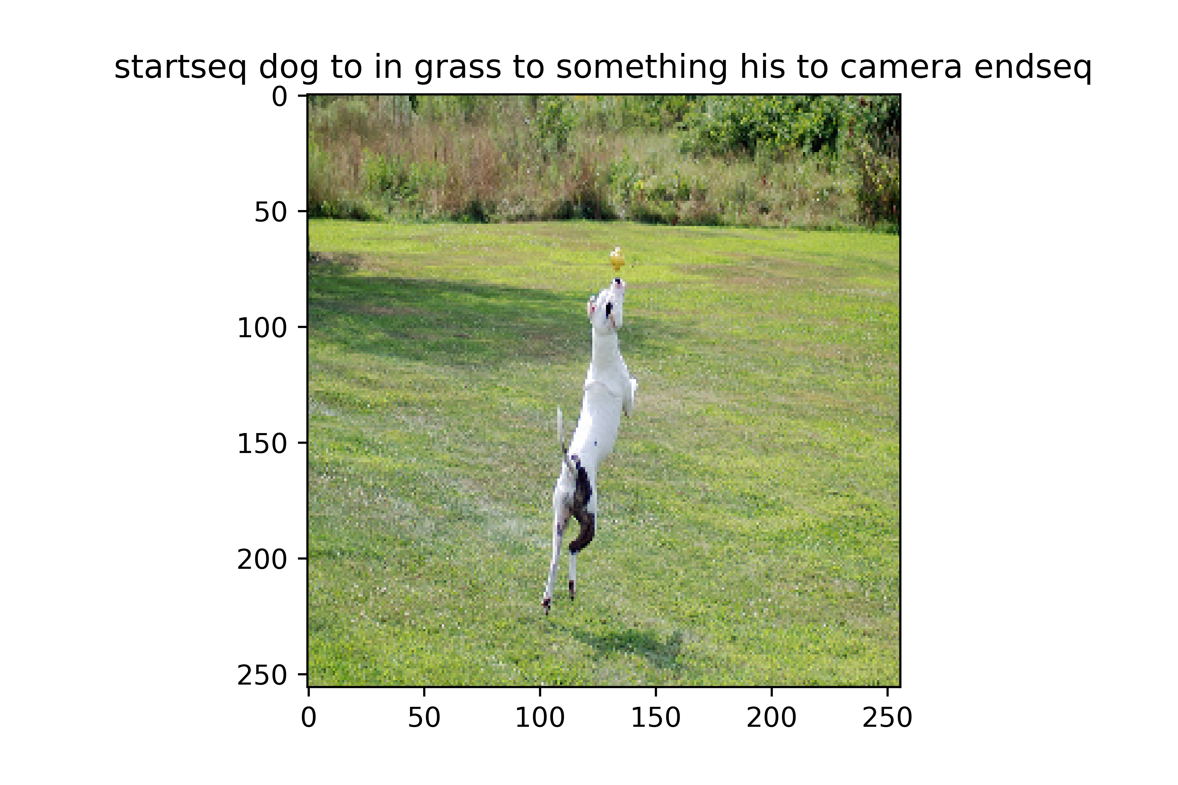
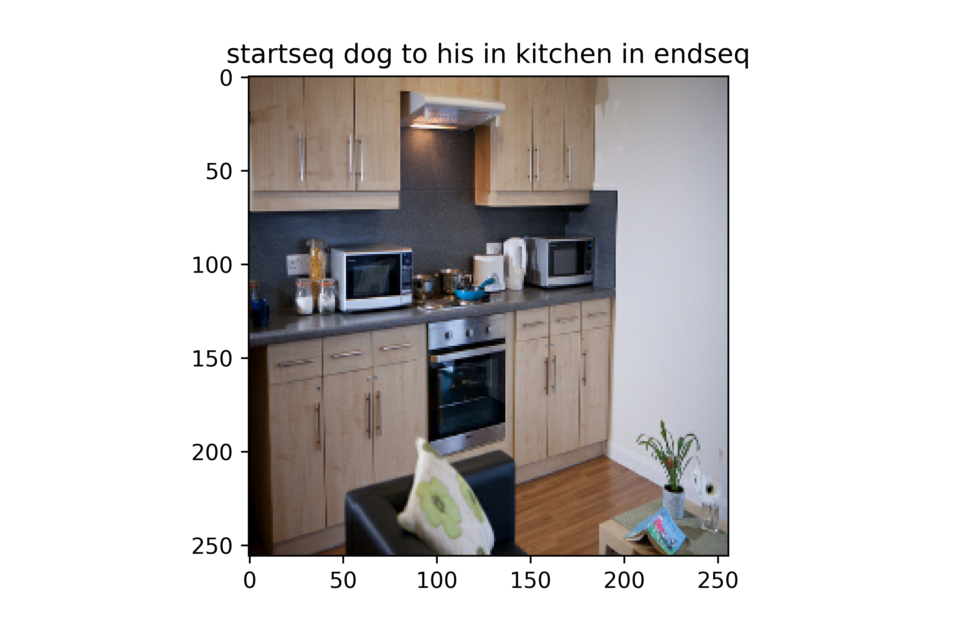
Results and discussion
GT: 'startseq black and white dog jumping in the air to get toy endseq'
GS: startseq dog to in grass to something his to camera endseq
BS :and dog through grass yellow
BS RF: ‘and dog catching in grass’
GT: 'startseq kitchen with cabinet and microwave endseq'
GS: startseq dog to his in kitchen in endseq
BS : and dog through kitchen
BS RF: dog through kitchen in

Slide 25
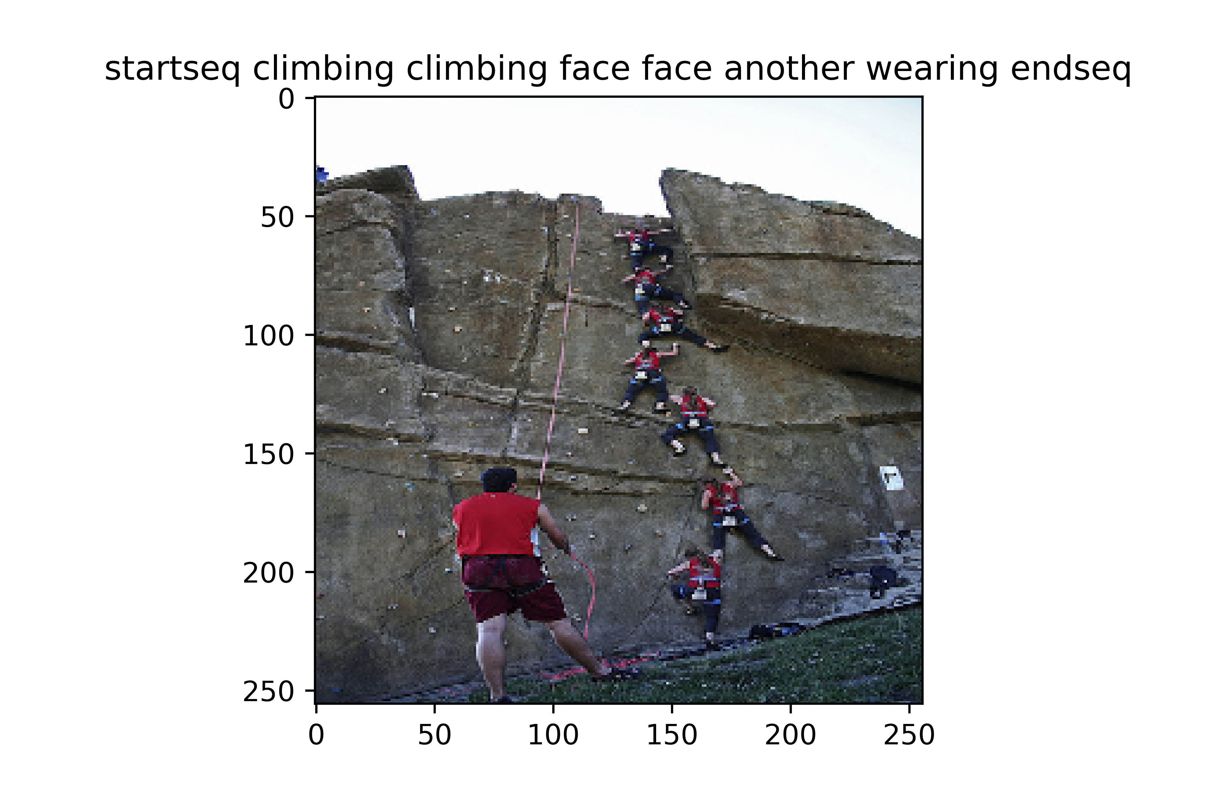
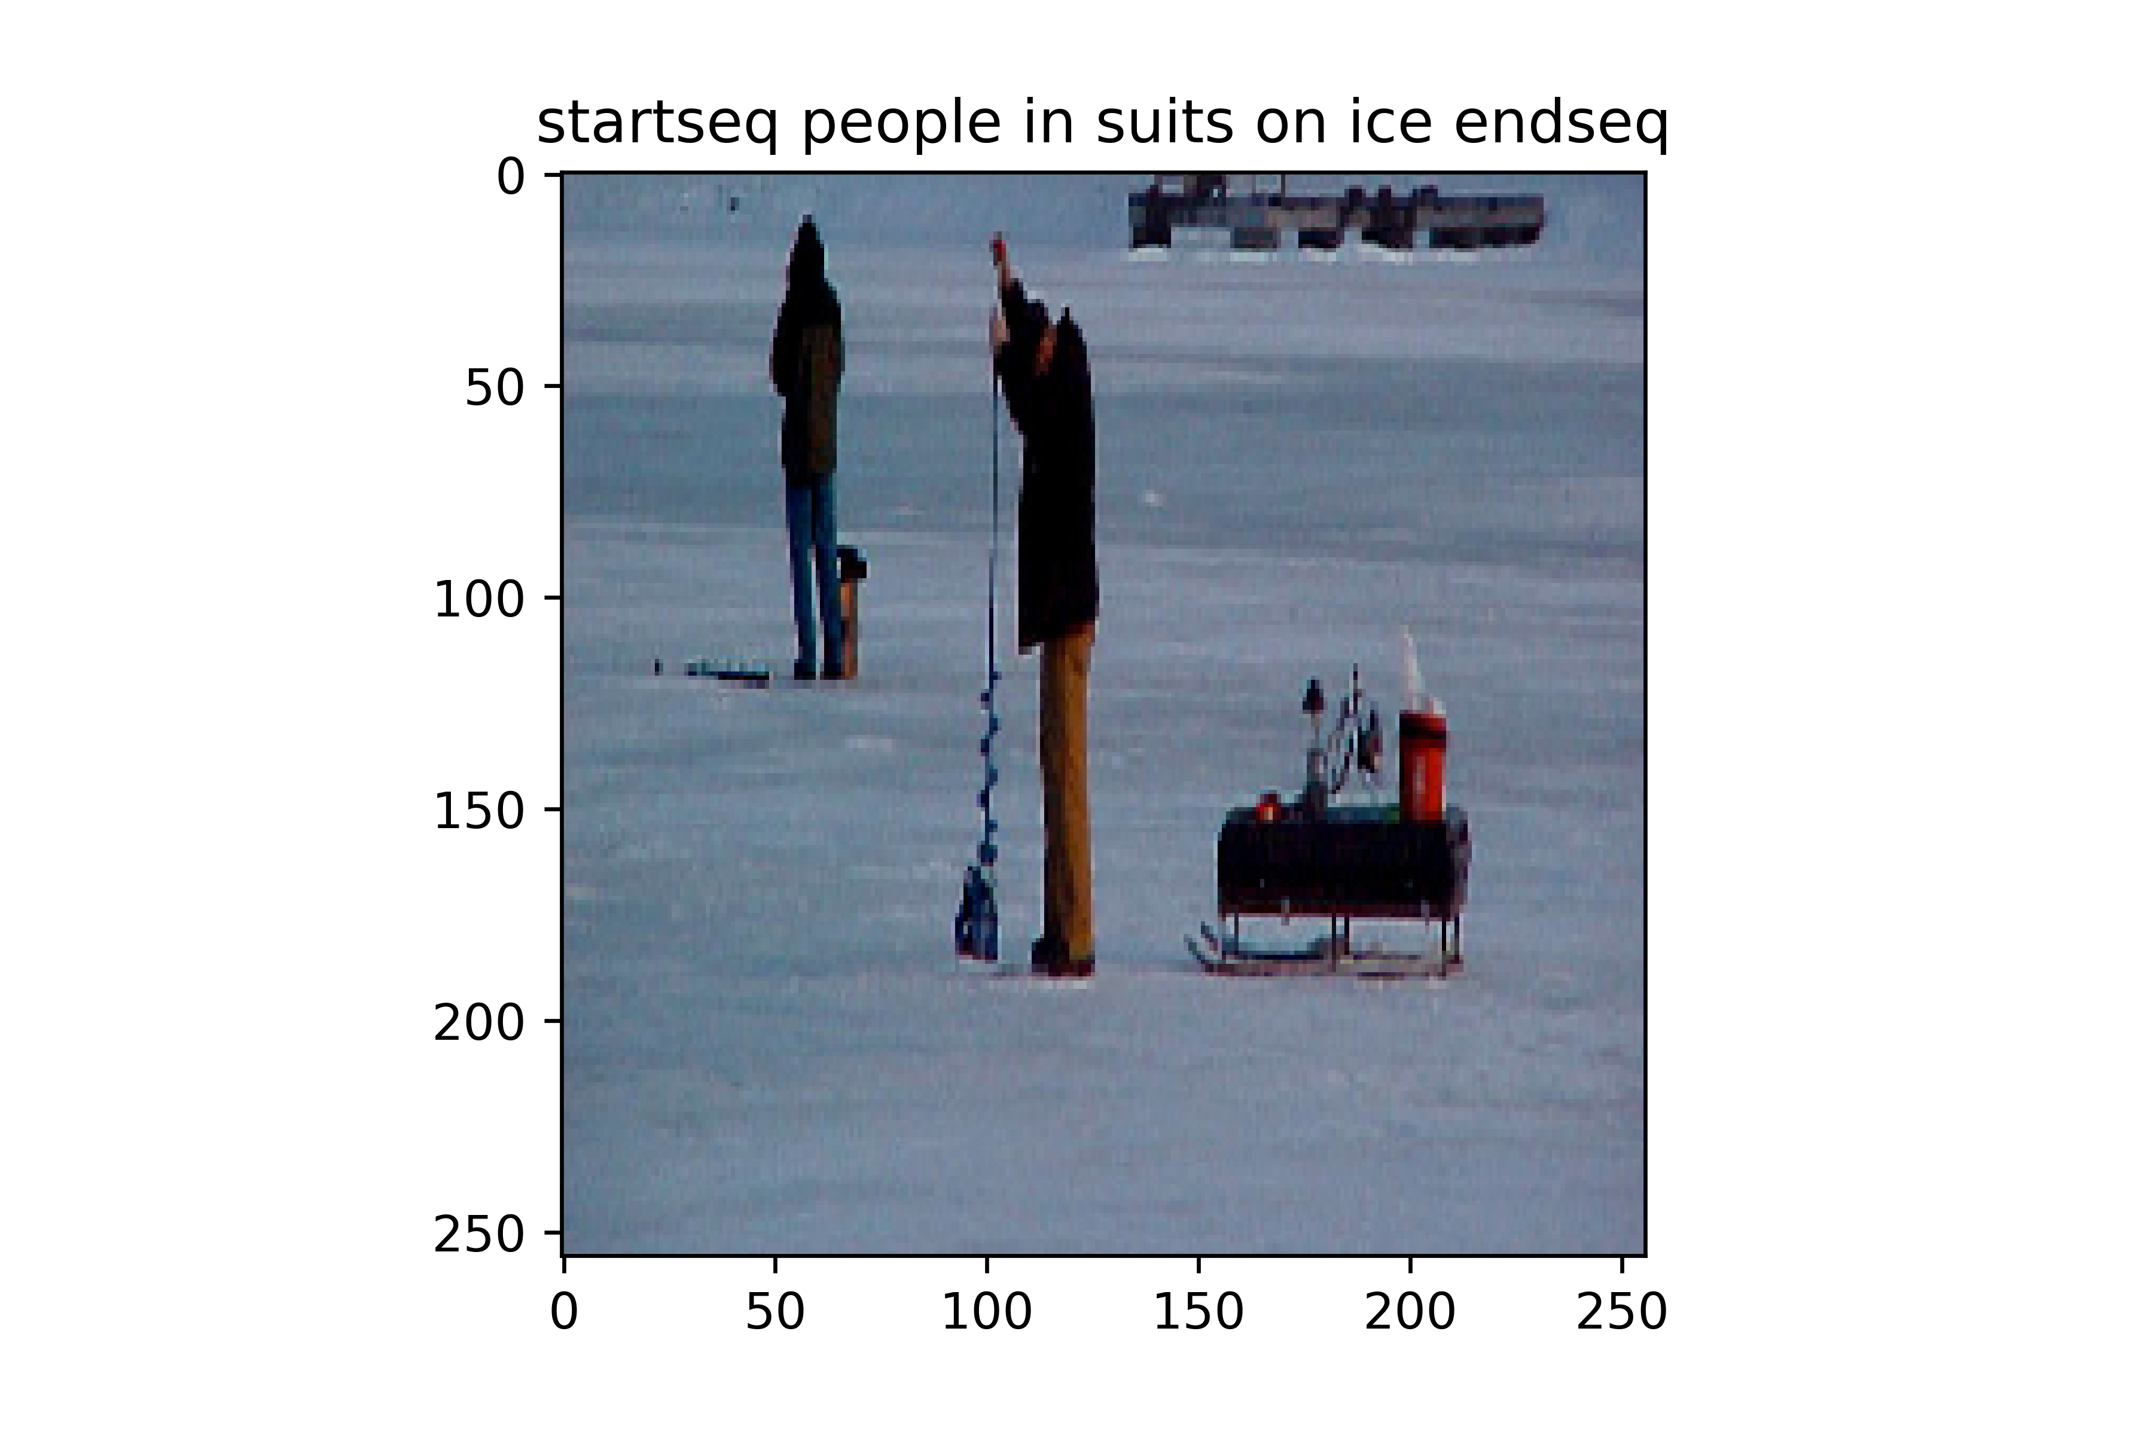
Results and discussion
GT: startseq group of people are rock climbing on rock climbing wall endseq
GS: startseq climbing climbing face face another wearing endseq
BS :climbing climbing face rock
BS RF: is climbing cliff face in of while in
GT: 'startseq man drilling hole in the ice endseq'
GS: startseq people in suits on ice endseq
BS : with people belongings the with belongings the in background behind
BS RF: ‘with people belongings in ice’

Slide 26
Thank you

